Slide 1


Business Plan of PDL business in Myanmar prepared by APAC team
7 October 2016

Slide 2
Table of contents
1
Investment Summary
2
Market Overview
3
Legal Setup
4
Product and Business Process
5
Digital Sales
6
Decision Making & Collection
7
IT
8
HR & Admin Information
9
Finance
10
Project Plan
11
Appendix

Slide 3
Investment Summary

Slide 4
Investment summary
MARKET ATTRACTIVENESS. Myanmar market may provide a lot of opportunities for new players.
We believe that it is necessary to enter to Myanmar consumer lending market because:
1
Large population (>51 mln people) with rising wages, high portion of young spenders
2
Since 2011 the political situation in Myanmar has stabilized and began to improve rapidly: the military regime fell, borders were opened, international sanctions were cancelled. First elections won by National League for Democracy, allows us to say that Myanmar has overcome the troubled period of its history.
3
Favourable investment climate:
5 billion USD investment brought into the country only for the first 2 months of 2016.
According to the forecast of McKinsey* “there is unique opportunities in Myanmar”. The level of investments in country's economy in the next 15 years will exceed $500 billion.
4
Very low level of bank`s consumer credit services:
Unsecured consumer lending is totally absent. Banks focused on SME lending with collateral.
Gray lending market share is very high: unbanked people are currently covered by low-tech informal lenders and pawnshops.
5
One of the highest smartphones penetration in Asia (80% in the big cities)
6
Payment systems demonstrate a booming growth.
Everybody who has smartphone can open e-wallet in 5min.
* http://www.mckinsey.com/global-themes/asia-pacific/myanmars-moment

Slide 5


Investment summary
Key success factors in the market:
Variety of legal setup is possible. Optimal way to enter the market is pawnshop. After entering the market we are going to pursue acquiring of Microfinance company license.
Pure online is feasible. The market is ready for online lending despite low income: explosive smartphones penetration growth, mobile operators offer free access to Facebook
Easy to deliver money: 1) Transfer by “domestic remittance” through any bank without account opening (KYC provided). 2) Transfer to customers` bank accounts*. 3) Transfer to e-wallets of payment systems.
Myanmar is a very attractive market because of its:
low level consumer lending competition
possibility to apply pure online model
*according pilot website launch, we expect that penetration of bank accounts will be well above average in customer segment attracted through the online channel.

Slide 6
Investment summary
Investments, thsd USD | Year 1 | Year 2 | Year 3 | Year 4 | Year 5 | Total
Portfolio investments | 1 007 | 1 946 | 438 | 64 | 0 | 3 455
OPEX and CAPEX investments | 1 208 | 245 | 90 | 0 | 0 | 1 543
Total Micromoney investments | 2 215 | 2 191 | 529 | 64 | 0 | 4 998
Volume indicators | Year 1 | Year 2 | Year 3 | Year 4 | Year 5 | Total
Number of loans issued, thsd | 30 | 173 | 351 | 520 | 620 | 1 694
Amount disbursed, thsd USD | 2 484 | 14 095 | 28 198 | 41 569 | 49 284 | 135 630
Net portfolio (EoY), thsd USD | 612 | 2 059 | 3 634 | 5 000 | 5 348 | 16 652
P&L, thsd USD | Year 1 | Year 2 | Year 3 | Year 4 | Year 5 | Total
Revenue | 626 | 4 517 | 9 871 | 15 179 | 18 603 | 48 797
Provisions | -543 | -2 703 | -4 965 | -6 636 | -7 914 | -22 762
Variable costs | -510 | -1 272 | -2 337 | -3 400 | -3 979 | -11 498
Marketing acquisition costs | -369 | -608 | -1 112 | -1 577 | -1 775 | -5 441
Salary (variable part) | -94 | -340 | -548 | -781 | -927 | -2 690
Other variable costs | -40 | -199 | -359 | -530 | -631 | -1 759
VAT | -7 | -126 | -318 | -512 | -645 | -1 608
Fixed costs | -956 | -1 069 | -1 004 | -1 127 | -1 170 | -5 327
Salary (fixed part) | -682 | -701 | -588 | -713 | -793 | -3 476
Other G&A expenses | -275 | -369 | -416 | -414 | -377 | -1 851
One-off expenses | -57 | -17 | -17 | -17 | -17 | -126
Net profit before taxes | -1 441 | -545 | 1 548 | 3 999 | 5 523 | 9 084
Terminal value |  |  |  |  |  | 25 063
ROE (annualized) |  |  |  |  |  | 61%
ROAA (yearly) | -235% | -41% | 54% | 71% | 80% | 51%
Break-even period – 21 months; Self-capitalization period – 29 months; Payback period – 58 months
Total investments from Micromoney – $5,0M; Unoptimized Yr5 corporate tax – $1,4M
Terminal Value – $25,1M (Gordon growth model with discount factor 15% and growth rate 0%)

Slide 7
Market Overview

Slide 8
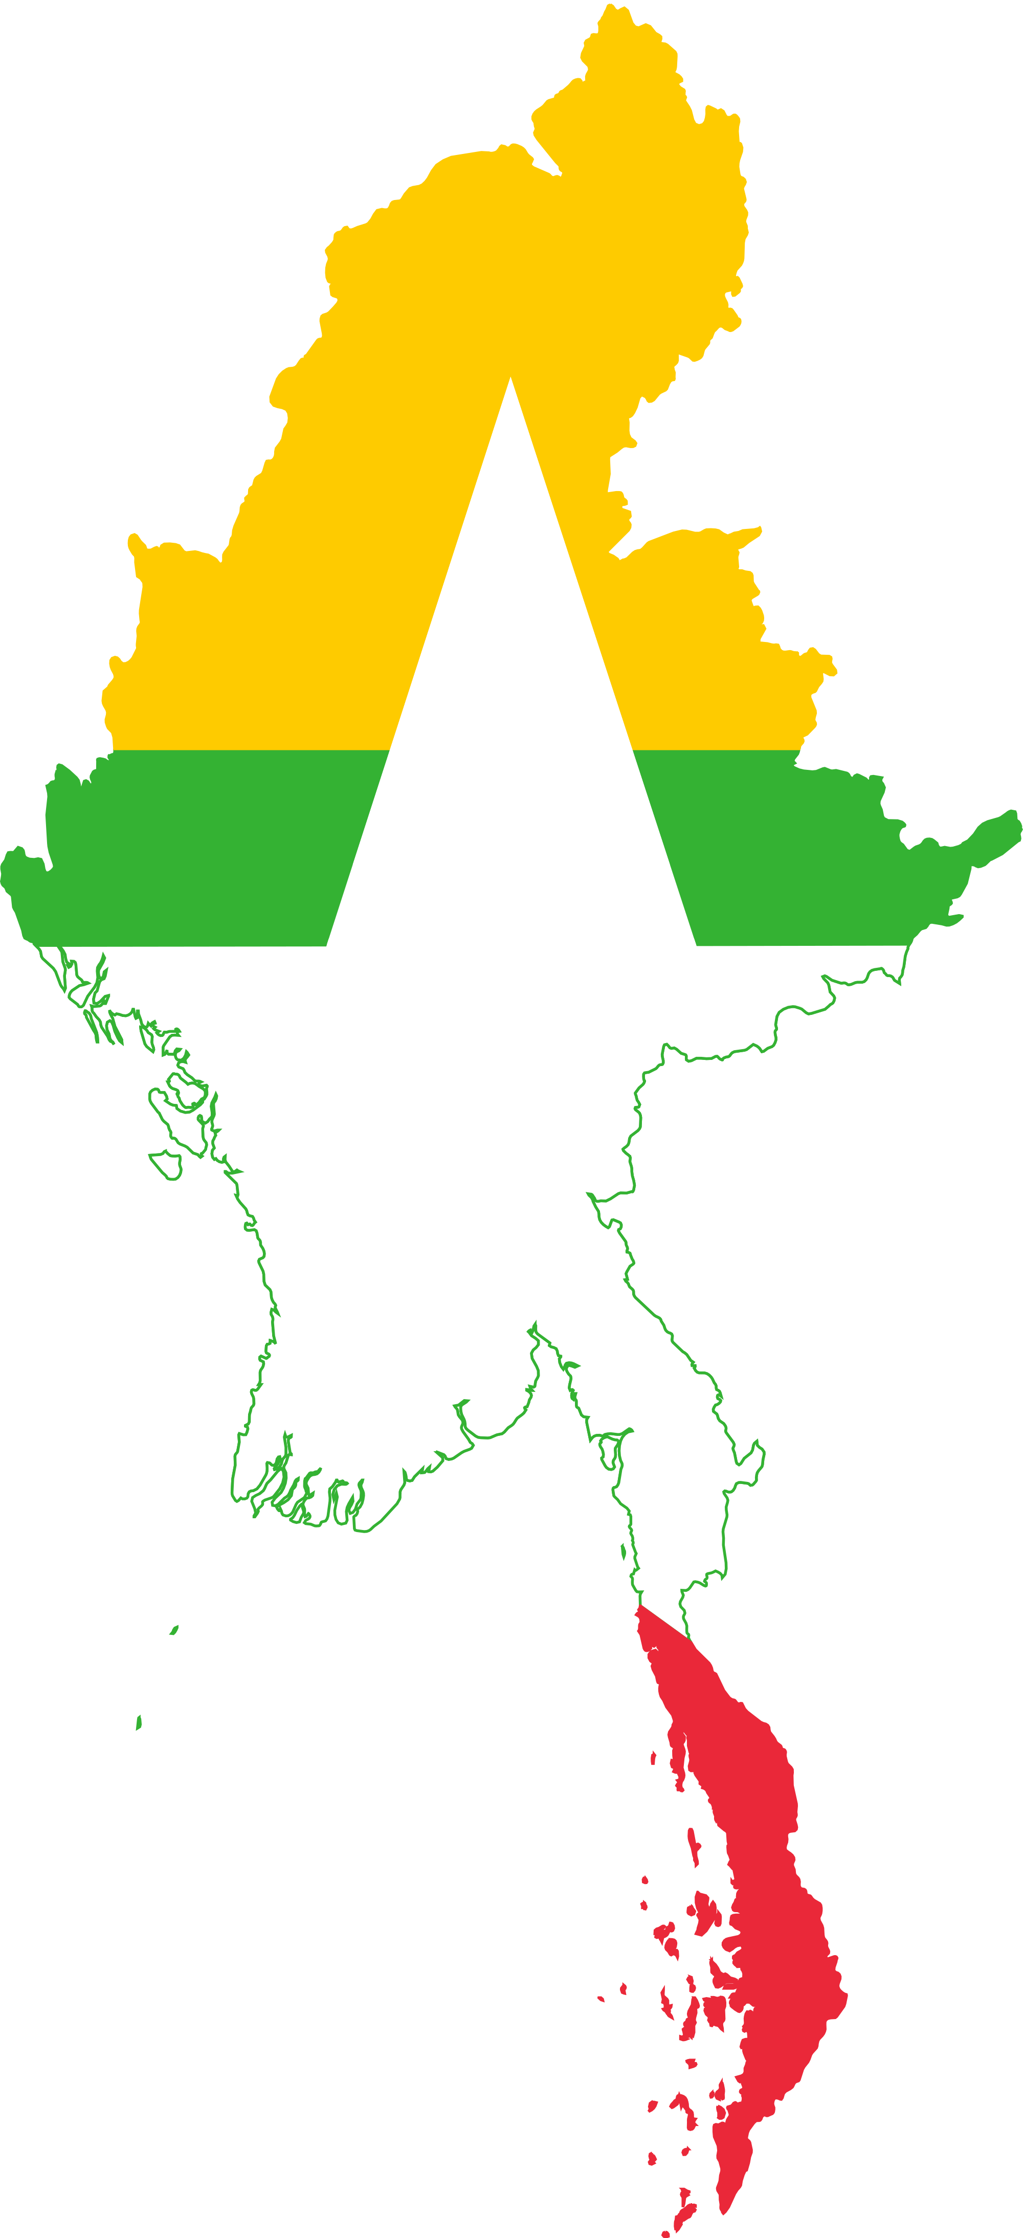
General market information
Parameter | Myanmar | Yangon city
Population (mln.) | 51,4 | 5,9
Official language | Burmese
GDP per capita* | $1.4K | $2,7K
Labour force ratio | 63% | 70% +
GDP nominal Annual Growth Rate (2015)*** | 7%
Officially employed | 30% | 50%+
Average monthly salary**** | $150 | $300
Min. salary for official employed citizens by labor law | $99
Mobile phone penetration (including smartphones)** | 33% | 63.5%
Smartphone penetration (out of mob. penetration) | 58% | 80%
Bank branches per 100K population | 2,5 | 10
Bank cards penetration****** | 5% | 20%
Facebook penetration | ~18% | ~ 52%
e-wallet (service provided by payment systems ) | ~ 300.000 | ~ 150.000
* http://mmrdrs.com/2015/09/03/investing-mandalay/ https://en.wikipedia.org/wiki/Myanmar
** The dynamics of mobile penetration increase was +87% in the last year. 3G is launched in Yangon and Mandalay
*** http://www.tradingeconomics.com/myanmar/gdp-growth-annual/forecast
**** estimations basing on local HR/JOB websites analysis.
****** http://www.kpmg.com/mm/en/issuesandinsights/articlespublications/documents/banking-and-financial-services-sector-in-myanmar-kpmg-publication.pdf

Slide 9



Yangon, and other 4 big cities -
the most suitable for our lending model as:
Around 20% of population lives there
Average salary - at least 3 times higher than in overall country, 38% of country GDP is produced only in Yangon.
Smartphone penetration on 40% higher than in country average, drastically increasing e-wallet penetration
March 2016 - Regulation on Mobile Financial Services was introduced and government start issuing the licenses for payment systems)

Slide 10




Consumer Finance Industry Landscape
In the past, Myanmar (Burma) was a British colony. Myanmar became an independent nation in 1948. Initially as a democratic nation and then, following the Civil war and a coup d'état in 1962, a military dictatorship. While the military dictatorship formally ended in 2011. Now the country fully turn into democracy.
The Banking technology is not developed yet. Local banks have no any interbank clearing system and send money to each other by fax. Also there is no REPO. Foreign bank`s branch expansion may exist only in the form of Joining Venture with local bank*. Foreign banks allowed to open only one branch and provide loans only to foreign enterprises. The main focus of banking industry is corporate customers. No any credit bureau presented in the country. The personal lending is mostly carried-out by NGOs, MFIs, cooperatives, pawnshops and unofficial money lenders.
The main efforts of Myanmar Financial authorities are dedicated to reduce the poverty and to promote the socio-economic life of the grass-root people in rural areas. It reflects in requirements for financial institution licenses holders to provide at least 50% of financing in rural areas. Thus, the most of existing micro finance industry players are focused on group-lending.
There are regulatory authorities which control the consumer finance market: Financial Regulatory Department of Myanmar Central Bank (MCB) – for all financial institutions, Rural Development and Poverty Reduction Committee in MCB – for MFIs. Agricultural, Livestock and Irrigation Ministry - for credit cooperatives. Yangon City Development Committee (under Prime Minister of Yangon region) – for pawnshops.
Banks are focused on SME lending, long and heavy process to borrow money for individuals.
Consumer lending is mostly represented by NGOs, MFIs, cooperatives, pawnshops and unofficial money lenders which works fully offline.
* http://www.crossroadsmyanmar.com/focus/banking-myanmar-nine-foreign-banks-enter-myanmar
* http://www.cbm.gov.mm/sites/default/files/regulate_launder/financial_institutions_law_updated_by_cbm_20160303website-1_0.pdf

Slide 11
Consumer Finance Industry Landscape
was a British colony
became an independent nation in 1948
Formally, military dictatorship ended in 2011
Now the country fully turn into democracy
The Banking technology is not developed yet
no any interbank clearing system
send money to each other by fax
no REPO
Foreign bank`s branch expansion may exist only in the form of Joining Venture with local bank*.
No any credit bureau
Requirements for financial institution licenses holders to provide at least 50% of financing in rural areas
The main efforts of Myanmar Financial authorities are dedicated to reduce the poverty and to promote the socio-economic life of the grass-root people in rural areas
Focus on group-lending
There are authorities that control the consumer finance market
Financial Regulatory Department of Myanmar Central Bank – for all financial institutions
Rural Development and Poverty Reduction Committee in MCB – for MFIs
Agricultural, Livestock and Irrigation Ministry - for credit cooperatives
Yangon City Development Committee– for pawnshops.
Banks are focused on SME lending, long and heavy process to borrow money for individuals.
Consumer lending is mostly represented by NGOs, MFIs, cooperatives, pawnshops and unofficial money lenders which works fully offline.
* http://www.crossroadsmyanmar.com/focus/banking-myanmar-nine-foreign-banks-enter-myanmar
* http://www.cbm.gov.mm/sites/default/files/regulate_launder/financial_institutions_law_updated_by_cbm_20160303website-1_0.pdf

Slide 12
Consumer finance market size estimation
 | 2017 | 2018 | 2019 | 2020 | 2021
Our disbursement volumes, mln. USD | 2,5 | 14,1 | 28,2 | 41,5 | 49,2
Our Number of loans (thousand) disbursed per year | 30 | 173 | 351 | 520 | 620
Our market share in 2020 is expected to be more than 2,2% of existing consumer finance market
(MFI, Pawnshops and unofficial money lenders).
* http://www.mmse.gov.mm/eng/license - loan portfolio of NGOs and MFIs
**https://www.kpmg.com/SG/en/IssuesAndInsights/ArticlesPublications/Documents/Advisory-FS-The-Banking-Financial-Services-Sector-in-Myanmar.pdf

Slide 13
Licensing options
Parameter | Bank | Financial Company | MFI | Pawnshops | Cooperatives | P2P
Number of active licenses | 80 | 10 | 220 | 2000 | 8000 | Not regulated
Min.capital requirements | $20M for domestic* $75M for foreign | $2,4M ** | $400k (was increased from $30k for local MFI and $50k for foreigner MFI from august 2016) | $2K-$10K (depends on township) Yearly | $15k | Not regulated
Max. foreign share | 0% | 49% | 100% | 0% | 0% | 100%
Territory | Nationwide | Nationwide | Nationwide*** | Nationwide | Specific town | Nationwide
Interest rate cap | 13% per annum | 36% per annum | 30% per annum | 30% per annum | 24% per annum | Not regulated
Unsecured loans | Yes | No | Yes | No (only collateralized) | Yes | Yes
Regulated by | Central Bank of Myanmar (CBM) | Central Bank of Myanmar (CBM) | Microfinance Supervisory Committee (part of CBM) | City Development Committee (Prime Minister of Yangon region) | Cooperatives department (Agr., Livestock and Irrigation Ministry) | Not regulated
Av licensing timing | >6 m | >3 m | Up to 5 month | 2m | 2m | Not regulated
It is possible to work as pawnshop, MFI and P2P.
According to our experience Pawnshop licence is preferable in the market like MM due to relatively simple requirements and non-strict regulation if compared with MFI.
However since money lending market is getting mature and more regulated, we should consider obtaining MFI license on the next phase of development.
* http://www.nationmultimedia.com/aec/Central-Bank-raises-capital-requirement-for-local--30252219.html
** https://www.giz.de/en/downloads/giz2013-en-financial-sector-myanmar.pdf
*** every province entry should be approved by the related regional governments

Slide 14
Legal Setup

Slide 15
Regulation of MFI company and Pawnshop
 | Microfinance company | Pawnshop
Regulator | Financial Regulatory Department is in charge of MFI license issue. Microfinance Supervisory Bureau Microfinance Supervisory Committee | Revenue Department, as the subdivision of Yangon City Development Committee (analogue of City Hall)
Document regulating Money lending | Microfinance Law (2011). Directive from MSC 1-2014, 2-2014. Financial Institutions Law 2016 (Pyidaungsu Hluttaw Law No. 20, 2016) | The Constitution of the Republic of the Union of Myanmar, 2008, Act 188 Licensed personal Loan Business Authorisation Agreement. 1 April 2013
Mandatory documents for Money lender | Microfinance License | Pawnshop License from Yangon City Development Committee
Associated risks | MFI license can be rejected if the background of parent company is not clear (Money laundering suspected, bad reputation of parent company, if there is no experience in microfinance in another countries) | Current legislation prohibits foreign companies or persons from doing pawning business in Myanmar. Therefore related business to be carried out via nominal private person, that needs to be properly coordinated
Risk mitigation | Regulator forces MFIs to provide 50% loans in rural areas | Utilize a set of documents that restrict nominee power
Regulation practice | Ownership: 100% of shares can be owned by foreign company. Since august 2016 minimum paid up capital increased to 400к. | Easy to get pawnshop license: in 2 month. 5000 USD deposit .
Summary: | - It is a long process to get MFI license, but it is possible and might take up to 6 month. - When our turnover will growth enough, it is worth to consider to get MFI license as the very appropriate for our business model for the future. | - Pawnshop license is easy to get. Regulation is not strict. Revenue Department has not enough resources to supervise all the pawnshops. - Nominee risk, does not fit «IPO-able» corporate structure.

Slide 16









Key regulatory points ( 1/2)
Sphere of regulation | PAWNSHOP | MFI
Ownership | 100% - local nominee | 100% by foreign company
New license issuance | 2 month | Up to 5 month
APR/EIR interest cap | 36% per year | 30% per year
Additional fees can be charged by passing % rates | Fees can be charged thorough “Lead Generation Company” | Fees can be charged thorough “Lead Generation Company”
Allowed credit products / collateral safe keeping | To copy Vietnam scheme: to take phone as collateral, and keep it in the hands of the owner. | Unsecured loans
Advertising requirements | We must follow Consumer Protection Law, and not provide false information. | Forbidden to provide false information. (article 166 of Financial Institution Law)
Face-to-face customer verification | Not obligatory | Not obligatory
Remote contract signing | Remote contract signing is possible: “it requires that the proposal and the acceptance of the proposal are communicated” | Remote contract signing is possible: “it requires that the proposal and the acceptance of the proposal are communicated”
License territory coverage | 1 license = 1 branch. no restriction on customers residency. | submitting an application for a license we can choose up to 4 regions. To add new region - subject to regulatory approval (up to 4 month)

Slide 17





Key regulatory points ( 2/2)
Sphere of regulation | PAWNSHOP | MFI
The funding of the loan portfolio | -Pawnshop can receive loans from the local company LGC (LGC – is 100% foreign owned company by Micromoney). For ex.: loan secured by its’ pawn credit portfolio | - Foreign MFI can receive funding from parent company (top-up paid up ). - Loans up to 3mln usd from any foreign finance institution. Any loan is subject to regulatory approval (up to 2 month). Conditions approved by the government: 13% p.a. max.
Money transfer from abroad | - Any loan from abroad requires approval of Central Bank - Any transactions of > $ 85k have to be reported to the anti-money laundering department of the Central Bank | - Any loan from abroad requires approval of Central Bank - Any transactions of > $ 85k have to be reported to the anti-money laundering department of the Central Bank
Debt collection | Not regulated. | Not regulated.
Associated risks: | Current legislation prohibits foreign companies or persons from doing pawning business in Myanmar. Therefore related business to be carried out via nominal private person, that needs to be properly coordinated | The regulator has power to issue directions as to the manner in which any aspect of business of a microfinance company are to be conducted.
Risk management: | Utilize a set of documents that restrict nominee power. To avoid nominee risks, all loans issued by the pawnshop, could be transferred to LGC company by assignment agreement. | Regulator forces MFIs to provide loans in rural areas (at least 50% of borrowers must live in the rural areas. The loan amount for rural customers is not defined. We will provide loans with amount of 1usd in rural area.
Both options are possible. For quick start, we will enter the market with pawnshop.
And when our turnover will growth enough we will change legal entity to MFI.

Slide 18




Equity participation
Link
Paid-up capital
Legal Setup Pawnshop
SG
Micromoney
Micromoney
100%
$50K
Funding by loans
100%
$100K
MM
The company
(name to be discussed)
Lead Generation Company
(Lead Generation
Co ltd)
Service agreement
Service agreement
Set of documents
Private person
with PAWNSHOP license
(nominee)
borrowers
Loan agreement
The set of documents which will be signed with pawnshop nominee
1.MASTER AGREEMENT ON BUSINESS CO-OPERATION
2. CAPITAL CONTRIBUTION ASSIGNMENT AGREEMENT
3. LOAN AGREEMENT
4. EQUITY INTEREST MORTGAGE AGREEMENT
5. GUARANTEE AGREEMENT
6. Agreement to control bank current account: signatures / stamps
Loan agreement

Slide 19
Product and business process

Slide 20
Consumer Lending Landscape
Parameter | Bank | MFI | MFI | Pawnshops | Unofficial Money Lenders
Loan amount | $100-10.000 | $70-$300 | $20-100 | $100-1000 | $100-10.000
Range/average tenure | 1-24 months | 50 weeks | 4 months | 1-6 month | 1-24 months
Collateral Guarantor | YES on amounts more $1000 NO for credit cards | No for group loans | Needed (Gold – Electronic - clothes) | negotiated | YES on amounts more $1000 NO for credit cards
Interest rate | 13% p.a. + establishment fees + legal fees +assessor fees | 30% flat (illegal***) + unofficial fees charged by DSAs Weekly repayments. | 36% according to pawnshop regulating** de facto - 120% p.a. | 60-240% ($500+)* 120-3600% (<$100)* | 13% p.a. + establishment fees + legal fees +assessor fees
Late fee | 3% per month | There are unofficial fees | - | No data | 3% per month
Prolongation fee | - | - | No | No | -
Time-to-money | 7-14 days | 2-5 days | 1 hour | Up to 1 day | 7-14 days
Loan disbursement channel | Cash \ POS \ credit card | Cash in MFI office \ DSA delivery | Cash in pawnshop office | Cash in hand / Money transfer | Cash \ POS \ credit card
Verification \ Documents required | ID + Family book + recommendation from police station + invoice + work prove | ID + Family book / recommendation from police station / additional documents | ID | ID, Recommendation by existing client / Referral | ID + Family book + recommendation from police station + invoice + work prove
Business model | Offline | Offline | Offline | Offline | Offline
Pawnshops and unofficial moneylenders are our closest competitors.
* Meeting with professional unofficial moneylenders ($500+). Feedback by street vendors (<$100)
** c4(c) YCDC Pawnshop Agreement, s19 & 23 Financial Institutions Law 20/2016
*** Microfinance Supervisory Committee Directive No. 2/2014: flat rate is illegal. De facto MFIs skip this regulation

Slide 21
Our Product parameters
Parameter | Value
Product type | Pay day loan (PDL)
Currency | Myanmar kyat (MMK)
Loan amount | 50K-300K MMK (equivalent of $41-250)
Loan tenor, calendar days | 7, 15, 21, 30days
Collateral | Officially borrower's mobile phone will be assumed as collateral, in fact it will still be kept by the customer
Interest rate | 29,2% per annum (0,08% per day)
Service fee (to be charged by LGC) | 0,92% per day (charged as a one-time fee for the whole LT)
Late payment fee (LPF) | 15K MMK (equivalent of 12,5 USD)
Overdue interest rate | 1,92% per day (charged as a one-time fee for the whole LT)
Prolongation fee | 0
Special features | LPF grace period 3 calendar days Prolongation condition - repayment of the 30% of LA
Time to money | 1 business day
Loan disbursement channel | 1st loan through domestic remittance or on bank account. Repeat loan through domestic remittance, bank accounts and payment systems: MobileMoney, Ok$, WaveMoney
Loan repayment channel | all repayments through bank transfers and payment systems: MobileMoney, Ok$, WaveMoney
Loan amount range
250k MMK | $ 205 | Yangon
200k MMK | $ 164 | Yangon
150k MMK | $ 123 | Myanmar
100k MMK | $ 82 | Myanmar
50k MMK | $ 41 | Myanmar
Tenure | Service fee
7 days | 6,44%
15 days | 13,80%
21 days | 19,32%
30 days | 27,6%
We are offering single payment loan with certain range of loan amounts, tenures, and service fees. Customer allowed to do early repayments after passing 15 days.
In MM we plan to start with our standard PDL product – IR 1% per day, Overdue IR 2% per day.

Slide 22






Initial Sales Business Process
1. Application
2. Decision
3. Contract signing
4. Loan granting
SMS campaign
General stop factors check
Customer
Contact persons
Terrasoft Online BPM
Outbound call
Black lists
Phone verification
Additional information required
Data checking
Loan granting
BANKS
- Domestic remittance without opening an account
- Transfer to borrower's bank account from our bank account in same bank
Inbound call
Scoring
Pre-Approval
Decision
Approve:
Contract confirmation – sms / email
Mobile application
Reject
Reject
website
Transfer to customer’s bank account
Functionality already available in Terrasoft and planned to be used
New functionality&Integrations to be implemented in Terrasoft

Slide 23







Repeat Sales Business Process
1. Application
2. Decision
3. Contract signing
4. Loan granting
SMS campaign
Searching customer in Pre-approved list
Approval
Contract confirmation
BANKS with payroll service
- Domestic remittance without opening an account
- Transfer to borrower's bank account from our bank account in same bank
Outbound call
in-house Scoring
And Black lists
Loan granting
Transfer to customer’s bank account
Inbound call
request 1-2 additional cont. person and checking
Reject
Payment Systems
- Transfer to borrower’s e-wallet
from our investor`s e-wallet
Application
Transfer to customer’s e-wallet account
website
Terrasoft Online BPM
Accounting
system
Functionality already available in Terrasoft and planned to be used
New functionality&Integrations to be implemented in Terrasoft

Slide 24




Repayment channels
Easy to get an access
Hard to get an access
High penetration of banks branches in big cities (600 branches in Yangon), make bank transfers possible in Myanmar.
Different payment systems enables people to perform financial transactions using their mobile phones. Maximum limit per payment transaction per day is $164 (Classic account), $416 (Power account).
More popular
It is possible same-day settlement among all account-to-account transfers.
Penetration of bank accounts (10% out of total population in big cities) allows us to utilize Payment gateway facility. Access can be provided by local Banks directly or via specialized payment platform Myanmar Payment Union.
Big retail chain «Red Dot» with 10,000 of branches can accept to collect repayments from our customers.
Less popular
All payment channels are possible. We can start with bank transfers and shortly approach other channels.

Slide 25
Digital Sales

Slide 26
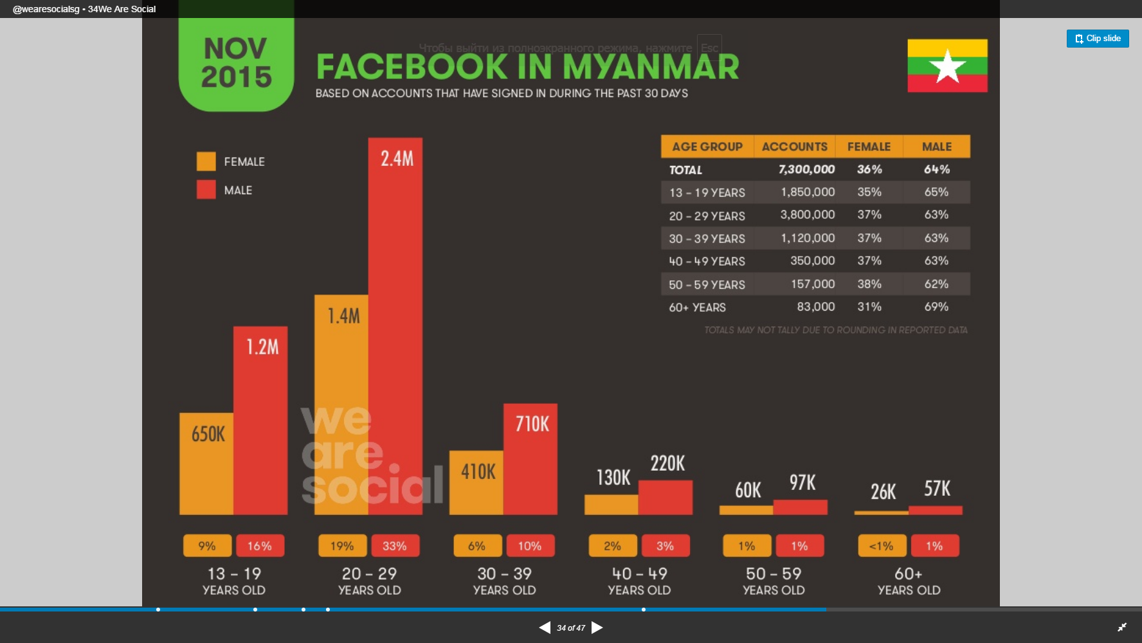
Facebook is the dominant digital channel
95% of our internet users explore internet surface via Facebook. (including search requests, data sharing etc)
Facebook users annual growth is more than 30% (9,5 mln users in august 2016)
Mobile operators in Myanmar offer free access to Facebook.
Source : OnDeviceResearch http://goo.gl/Zxw3p5

Slide 27
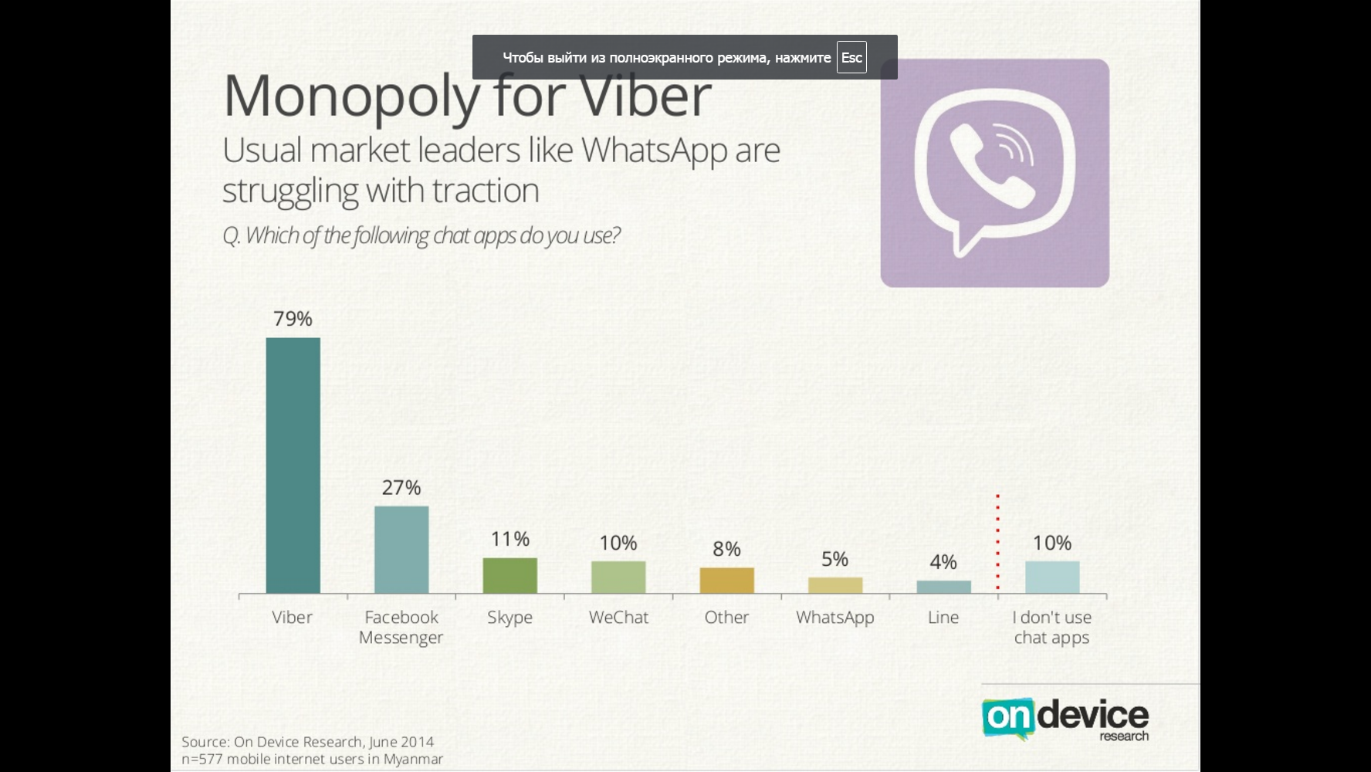
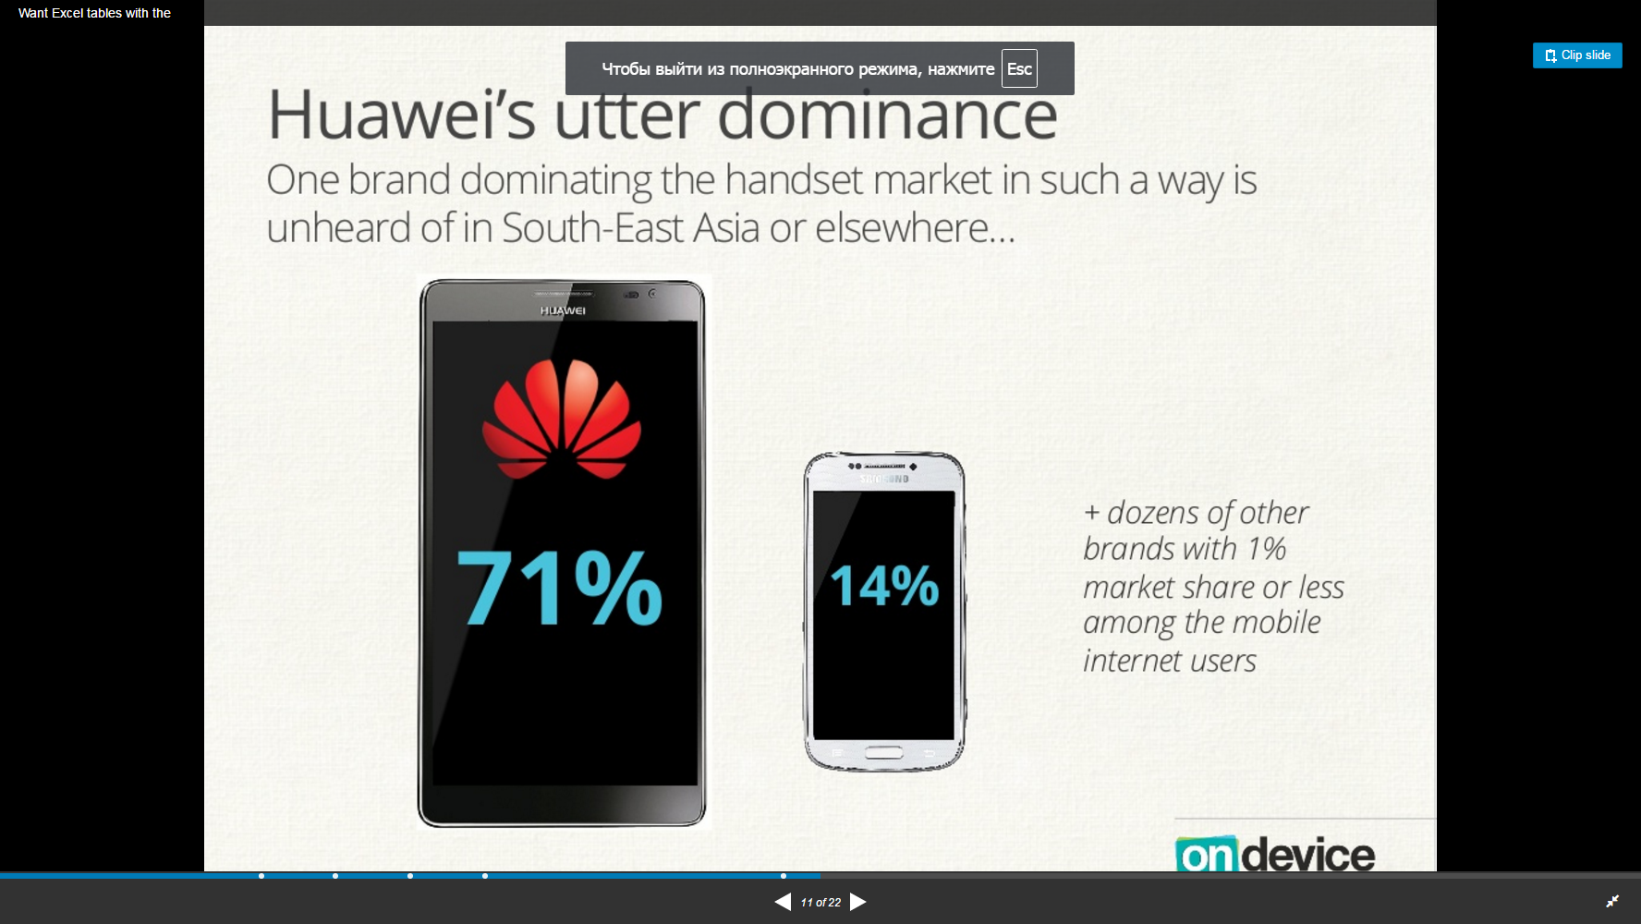
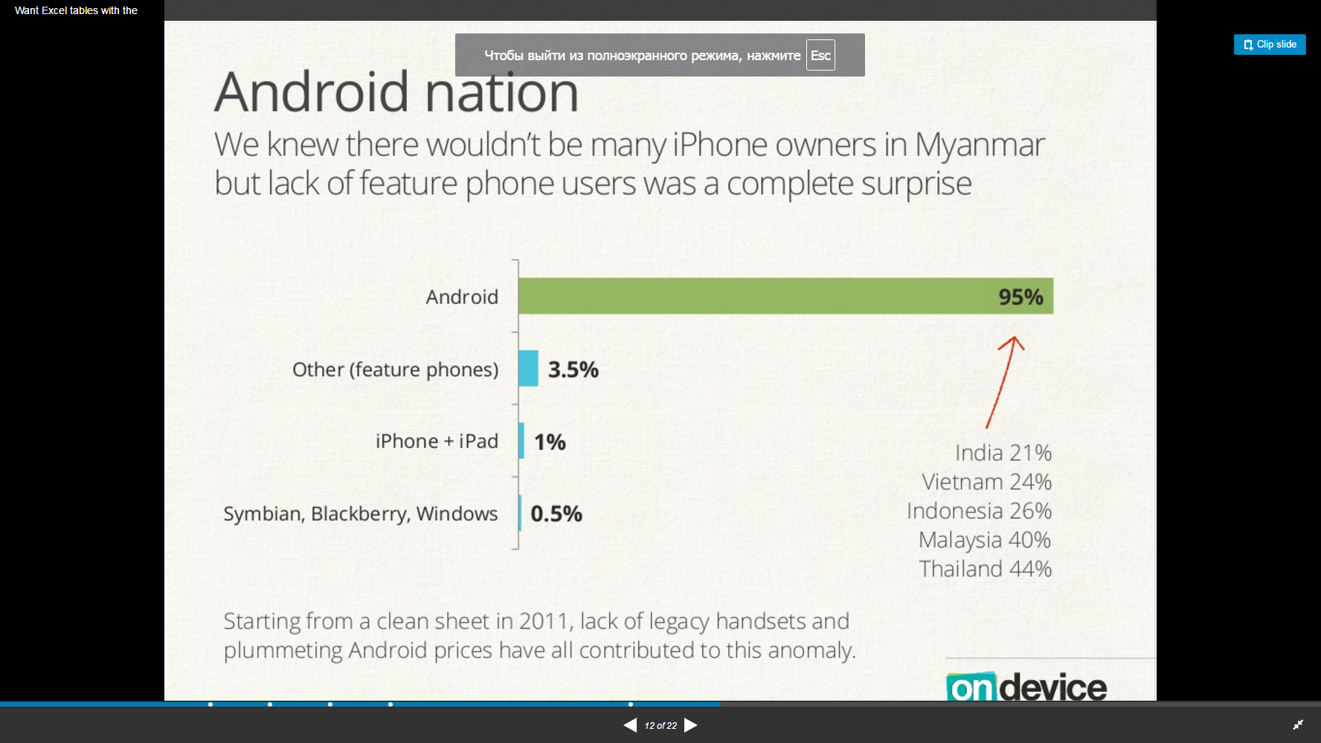
Facts from Myanmar digital space
Monopoly for Viber
Huawei`s utter dominance
Android nation
Usual market leaders like WhatsApp are struggling with traction
Q. Which of the following apps do you use?
One brand dominating the handset market in such a way is unheard in South-East Asia or elsewhere…
We knew there wouldn’t be many iPhone owners in Myanmar but lack of feature phone users was a complete surprise
Source : OnDeviceResearch http://goo.gl/TJ8jYC

Slide 28





Life testing of Myanmar digital space
in Myanmar is the main sales channel
was chosen for the pilot testing for our loan product.
Pilot Description
Pilot Results
The creation of advertisements.
For the viral effect we choose images with local currency, short and simple slogan.
2. Targeting:
men and women from 23 years to 65 years. Personal interests: finance, personal loans.
In 2 days of advertising we have got about
12,000 website visitors and 494 successful applications for the price of 6 cents each.
2. Advertisements have a great viral effect, which led the average cost of site visitor for less 1 cent.

Slide 29


Online advertising test: Advertising slogan
Our slogan:
Need Cash Urgently?
Borrow up to 500.000!
Fast and easy application process. Apply online now!
Easy to apply. Easy to get.

Slide 30
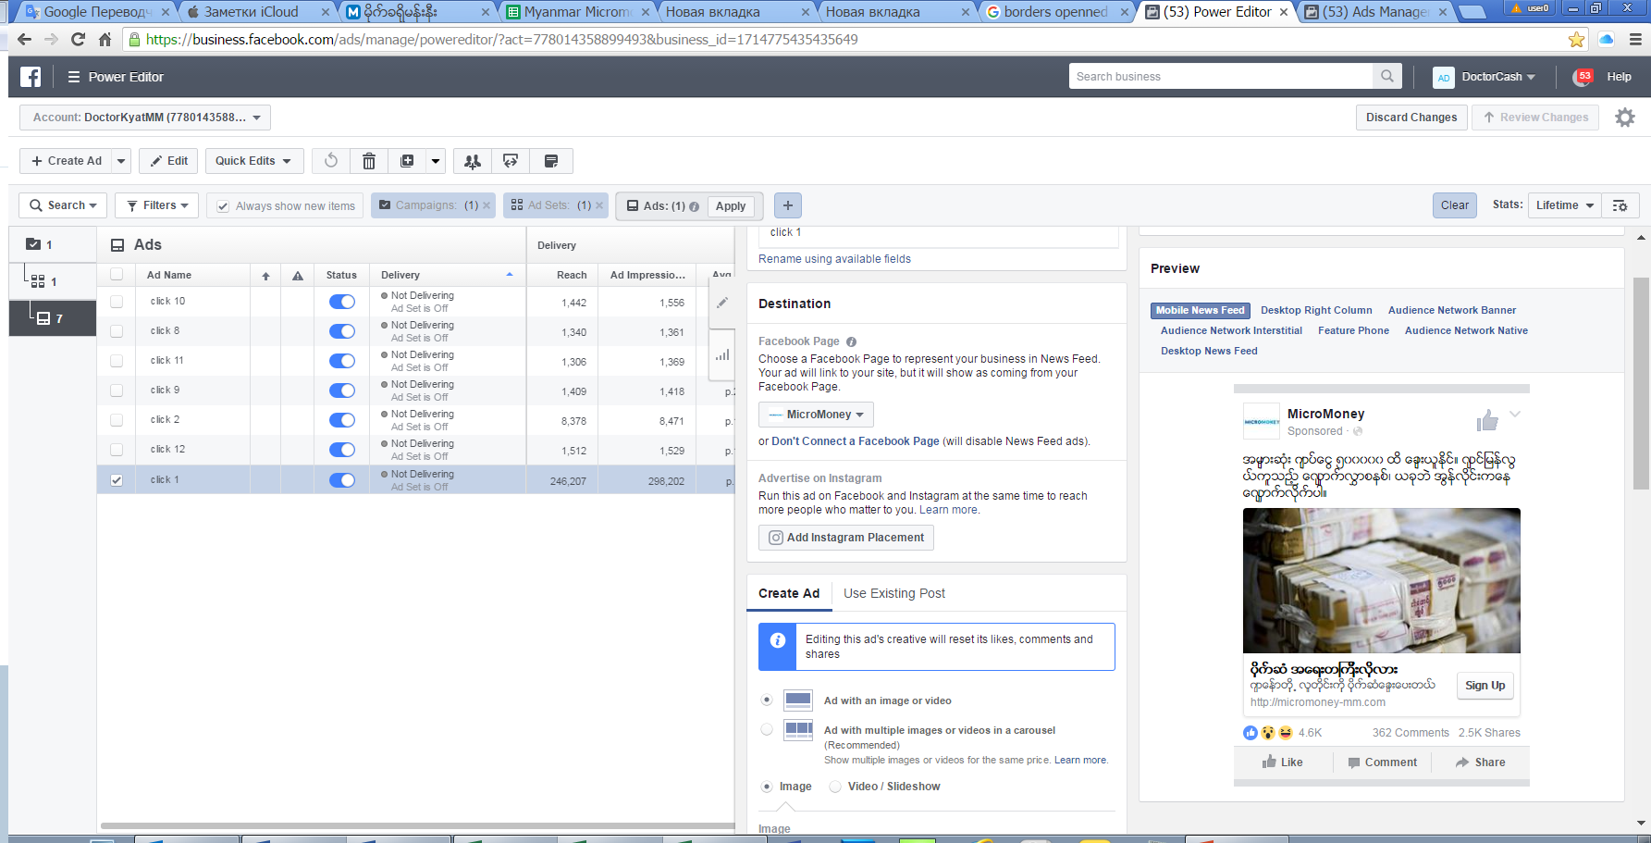
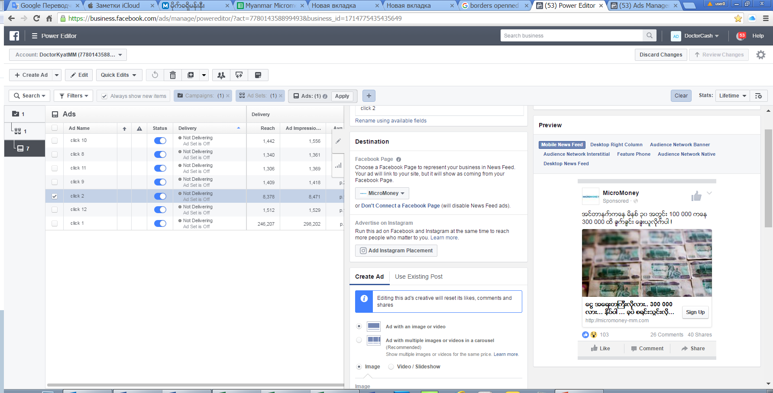
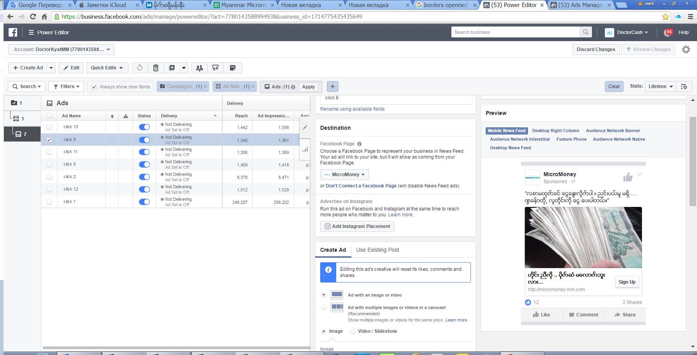



Customers acquisition via Facebook
Results in 2 days only:
2 500 Post shares
4 700 Likes
388 Comments
High efficiency of advertising campaign due to
Viral effect
Novelty offer

Slide 31
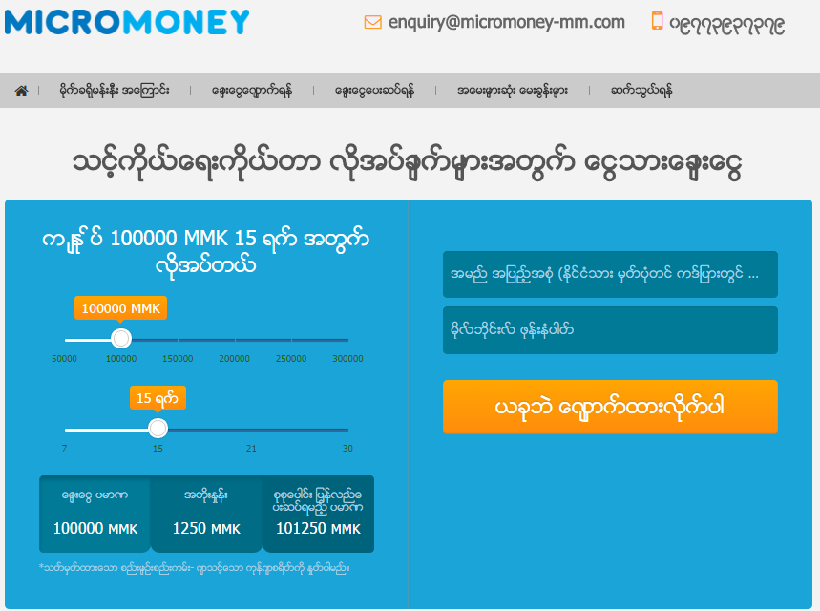
Online advertising test: website site design
We used MY model for the test campaign.

Slide 32
Online advertising test: Successful applications
FB-advertising
Date of advertising: 13-14 Aug
13 Aug – 14 Aug 472 Success app
From 15 Aug to 21 Aug (“long tail”) – 205 success app as “referrer” and “direct-traffic”

Slide 33
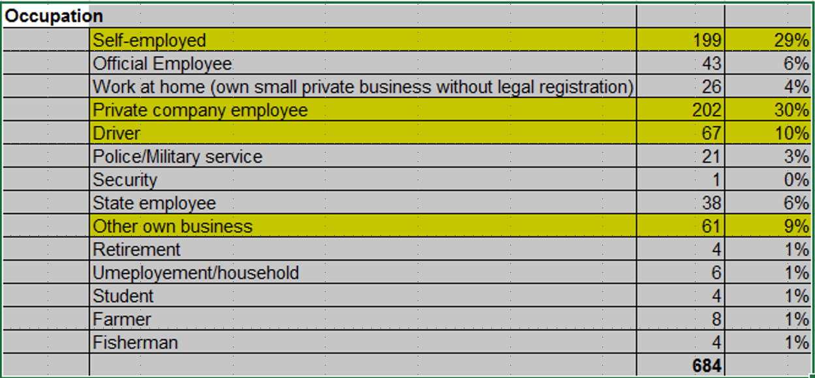
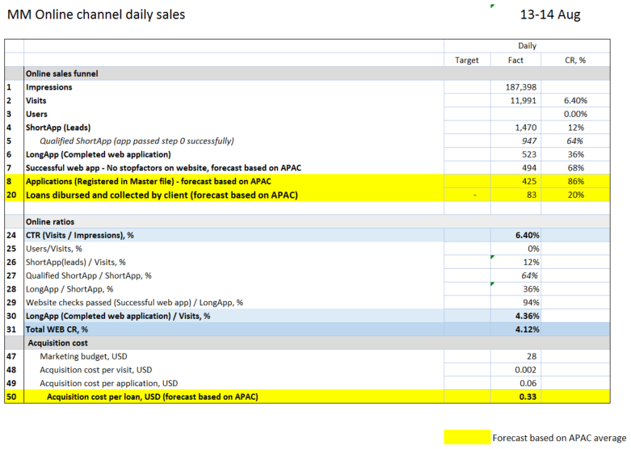
Online advertising test: sales results 13-14 Aug
Online sales funnel
Impressions | 187 398
Visits | 11 991 | 6,40%
Users |  | 0,00%
ShortApp (Leads) | 1 470 | 12%
Qualified ShortApp (app passed step 0 successfully) | 947 | 64%
LongApp (Completed web application) | 523 | 36%
Successful web app - No stopfactors on website, forecast based on APAC | 494 | 68%
Applications (Registered in Master file) - forecast based on APAC | 425 | 86%
Loans dibursed and collected by client (forecast based on APAC) | 83 | 20%
Online ratios
CTR (Visits / Impressions), % | 6,40%
Users/Visits, % | 0%
ShortApp(leads) / Visits, % | 12%
Qualified ShortApp / ShortApp, % | 64%
LongApp / ShortApp, % | 36%
Website checks passed (Successful web app) / LongApp, % | 94%
LongApp (Completed web application) / Visits, % | 4,36%
Total WEB CR, % | 4,12%
Acquisition cost
Marketing budget, USD | 28
Acquisition cost per visit, USD | 0,002
Acquisition cost per application, USD | 0,06
Acquisition cost per loan, USD (forecast based on APAC) | 0,33
SEX | People quantity
Female | 179 | 27%
Male | 473 | 73%
Salary | People quantity
< 213 USD | 191 | 29%
210 – 340 USD | 259 | 40%
340 - 510 USD | 142 | 22%
510 - 680 USD | 33 | 5%
> 680 USD | 27 | 4%

Slide 34
Marketing Mix & Marketing cost
Marketing tools* | Application volume | Lead cost | Estimation maximum monthly leads | TCR | Client cost (MAC) | Estimation maximum monthly clients
 | % | $ |  | % | $
Local Display Network | 15% | 3 | 1 472 | 18% | $ 18,75 | 265
Facebook | 85% | 0,8 | 16 391 | 18% | $ 4,44 | 2 950
Summary | 100% |  | 17 863 |  | $ 6,10 | 3 215
The assumptions based on results of pilot.
Average lead cost -$1,0
Average MAC cost -$5,5
Average monthly sales -3215 loans
During the first months we will manage our Marketing mix to achieve the optimal cost per client based on our digital marketing experience in Philippines, Indonesia, Malaysia and Vietnam
* Will be managed by in-house Digital Marketing Manager

Slide 35
Sales Plan
Short term sales plan
 | Month 1 | Month 2 | Month 3 | Month 4 | Month 5 | Month 6
Number of loans disbursed per month | 100 | 300 | 600 | 900 | 1200 | 1500
Share of new sales, % | 82% | 76% | 74% | 72% | 52% | 49%
Share of repeat sales, % | 18% | 18% | 16% | 14% | 34% | 35%
Share of prolongations, % | 0% | 6% | 10% | 14% | 14% | 17%
Long term sales plan
Parameter | EOY 1 | EOY 2 | EOY 3 | EOY 4 | EOY 5
Number of loans disbursed per month | 7900 | 21000 | 36000 | 49100 | 52200
New sales | 3400 | 6900 | 11200 | 14700 | 14800
Prolongation sales | 1600 | 8900 | 9300 | 13000 | 14400
Repeat sales | 2900 | 5200 | 15500 | 21400 | 23000

Slide 36
Decision making & Collection

Slide 37
Credit and Limit Policy
# | Rule | Description
1 | Customer segment | All customers, valid bank account is obligatory
2 | 1st loan policy | 50k MMK via Bank domestic remittance (15% of average salary, equivalent of 41usd) 100k MMK on bank account (30% of average salary, equivalent of 82usd) Loan amount does not exceed 30% of customer’s average monthly net Income Loan amount depends on the region, age, credit history and it is to be chosen from the list of 5 values [50k; 100k; 150k; 200k; 250k MMK]
3 | Tenure | 7, 15, 21, 30 days
4 | ID copy | not required
5 | Identification | Done at disbursement at the bank branch
6 | Address proof doc | Copy of the document is not required
7 | Income proof doc | Copy of the document is not required
8 | Credit bureau | No access to credit bureau in country now. It will be opened in 2 years (in 2016 passed Credit Bureau law)
9 | Anti-fraud auto checks | Following customer’s data to be cross-checked against existing customers who are delinquent: phone numbers, bank account numbers, IDs, contact and work phones, IPs, Devices.
10 | Work phone in application form | It has to be properly declared in the application
11 | Contact person in application form | It has to be properly declared in the application
12 | SMS confirmation of the phone | to be confirmed via SMS sent to customer’s phone number
13 | Verification phone requirement | Confirm identity of the customer. Confirm contact person phone number and relationship between customer and contact person.
14 | Employment & income check | Only some occupation knowledge questions (for customer and contact person)
15 | Income type & source of repayment | Customer can explain about source of repayment of the loan.
16 | Restricted occupation | Applications with following occupations must be declined: Police, Military, Communication/ Media/ PR/ Newspaper, Law/ Court.
17 | Disbursement channel | Bank transfer; Bank domestic remittance
18 | Repeat loan policy | Repeat loan 150k>200k>250k MMK (equivalent of 123>166>208 usd) Loan amounts 150k – 250k MMK with 50k MMK step, maximum cap - 50% of net monthly net income

Slide 38




Risk Management tools
Credit Bureaus
Internal scoring
Do not exist in the country as of now
Can be implemented after 6-8 from go live
Anti-fraud tools
Social data
Internal anti-fraud rules
iovation solution
Facebook data (should be available for more than 50% of applicants)
Messengers will be used as additional source to confirm identity

Slide 39
Target Collection strategy
Stage | Short Description | Stage Period | Resources | Stage
Pre – Due | SMS Notification borrower about payment Pre-due phone calls*, active prolongation sales | [- 5 … 2] days before/after due date | In-house Call center (soft collection) | SMS Notification borrower about payment Pre-due phone calls*, active prolongation sales
Soft Collection | Phone collection*, SMSs, e-mails. The threat of court action can prompt payment | [3 … 30] DPD – all clients [30-90] DPD – part of the delinquent clients | In-house Call center (soft collection) | Phone collection*, SMSs, e-mails. The threat of court action can prompt payment
Skip tracing | Look for new contact data, addresses, employers by Google Check and Facebook | 2+ | Separate skip-tracing In-house collection team | Look for new contact data, addresses, employers by Google Check and Facebook
Hard Collection | Field visit to living area, work, borrower’s relatives home. The threat of court action can prompt payment | [30+] DPD – part of the delinquent clients | In-house collectors | Field visit to living area, work, borrower’s relatives home. The threat of court action can prompt payment
legal collection | No legal collection, we will focus on Soft and Hard collection judicial procedures are not cost-effective. Minimum reasonable amount is 5,000 usd |  | No legal collection | No legal collection, we will focus on Soft and Hard collection judicial procedures are not cost-effective. Minimum reasonable amount is 5,000 usd
All phone conversations with customer will be recorded.
All meetings with customers will be recorded with audio and video

Slide 40
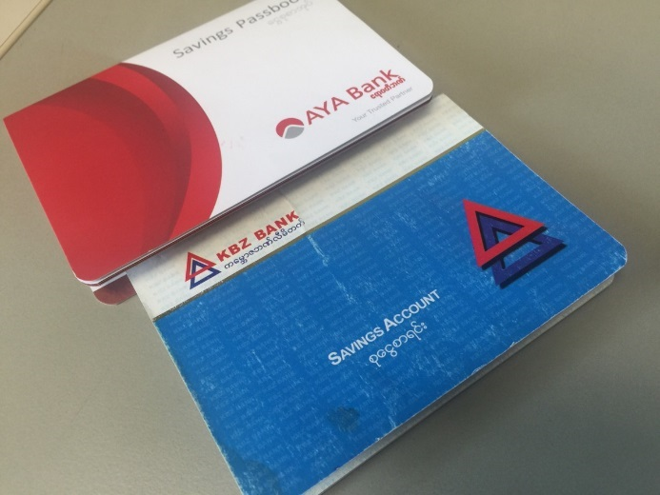
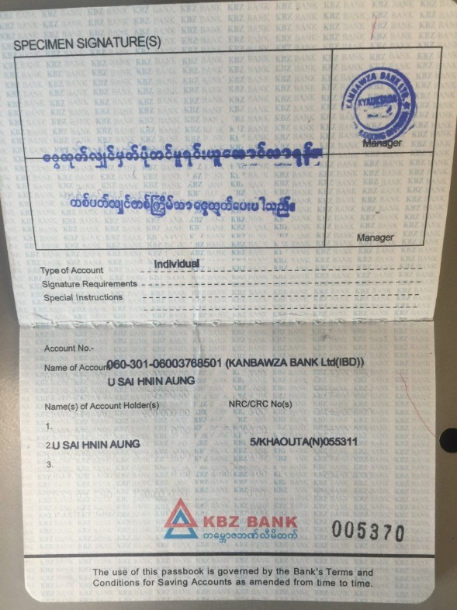
Money disbursement channels
Via bank accounts.
Standard account to account money transfer
Required: Full Name , bank account number, phone number
KYC: NRC card or passport, saving account book (presented on photo)
Via bank`s domestic remittance.
possible to send money to an individual without opening an account to any branch of bank
If there was now withdrawal, the money can be return back to sender
Required: Full Name , Home address , number of NRC or passport, Phone number
KYC: NRC card or passport
TOP bank penetration
Bank | YANGON branches | MANDALAY branches | Naypyidaw branches | Total | % of total branches | Total network branches across the country
KBZ Bank | 146 | 95 | 8 | 249 | 64% | 391
CB Bank | 74 | 36 | 7 | 117 | 73% | 161
AYA Bank | 66 | 25 | 5 | 96 | 61% | 157
MAB Bank | 21 | 8 | 3 | 32 | 42% | 77
GT Bank | 22 | 10 | 4 | 36 | 30% | 120

Slide 41
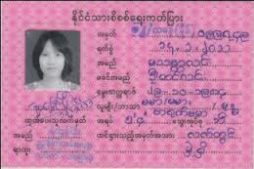
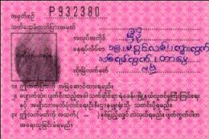

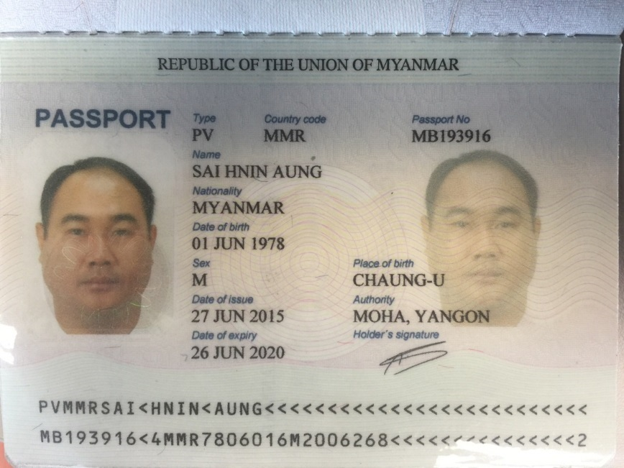
Customer identification/ banking KYC
Loans to be disbursed via banks only. We believe that bank identification on account opening will fully replace internal KYC.
Banks perform sophisticated check and require Passport or National Identity Card (NRC) to open an account.
Every Passport or NRC to be validated by bank employee, who must follow validation procedure (check security features)
Bank may confirm the validity of the official documentation provided through certification by an authorized person
National Registration Identity Card (NRIC)
Coverage - NRC covers 100% of citizens
Availability – 100%, in possession with clients all the time
Security features on the NRC
The following items fluoresce under a UV light:
pink security fibers
water mark (national flag with five-pointed star)
special paper as for banknotes with micro lettering
embossed plastic surface
Thumbprint
Current NRC
The Bank is responsible for validation of personal data provided by Customer (legal opinion)
Whoever forges an ID document shall be punished with 10 years imprisonment
NRC is always available, cost of obtaining the fake is higher than target loan amount
Current passport

Slide 42
Risk Loss curve
Start with the Credit rules, Anti-fraud rules, Phone verifications
Internal score card with a 1 year maturity of client’s payment details identified
Facebook data usage
Implement the first internal score card updated each 2-3 months
Using web history data, update of score card
Customer’s long term repayment behavior identified
Unsatisfactory customers identified and filtered out
We expect the risk loss for new loans to be 30~40% at the beginning and then decrease to 20% EOY1 and then to stabilize at the level of 19% for New loans and 14-15% for Repeat at EOY2.
From year to year risk will continue to decreasing as a result of risk strategies optimization.

Slide 43
IT

Slide 44
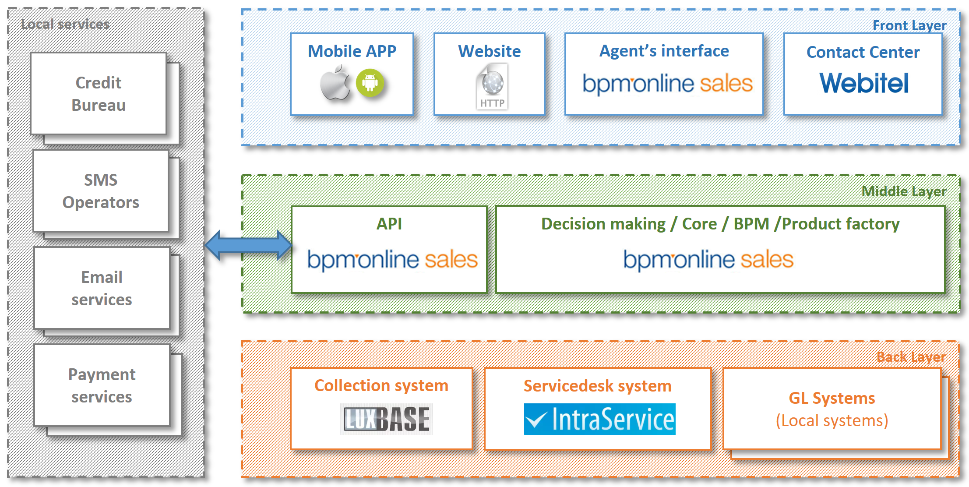
IT architecture

Slide 45
IT scope of work
Integration partner | Type of the partner | Comments
Berakah Peneil www.berakahpeneil.com www.odoo.com | GL system supplier | Odoo.com (GL system) regional integrator on Myanmar
TrueIDC www.trueidc.com.mm | Call-center service provider | Provides rental of workplaces ready to use for call-center
Ooredoo www.ooredoo.com.mm | SMS Aggregator
Banks: KBZ, CB, AYA, Amara Unites | Disbursement and Repayment | Domestic remittance
Myanmar Mobile Money MyKyat Ok$ | Disbursement and Repayment | Has the most number of gateways with banks, ATM networks and retail chain shops

Slide 46
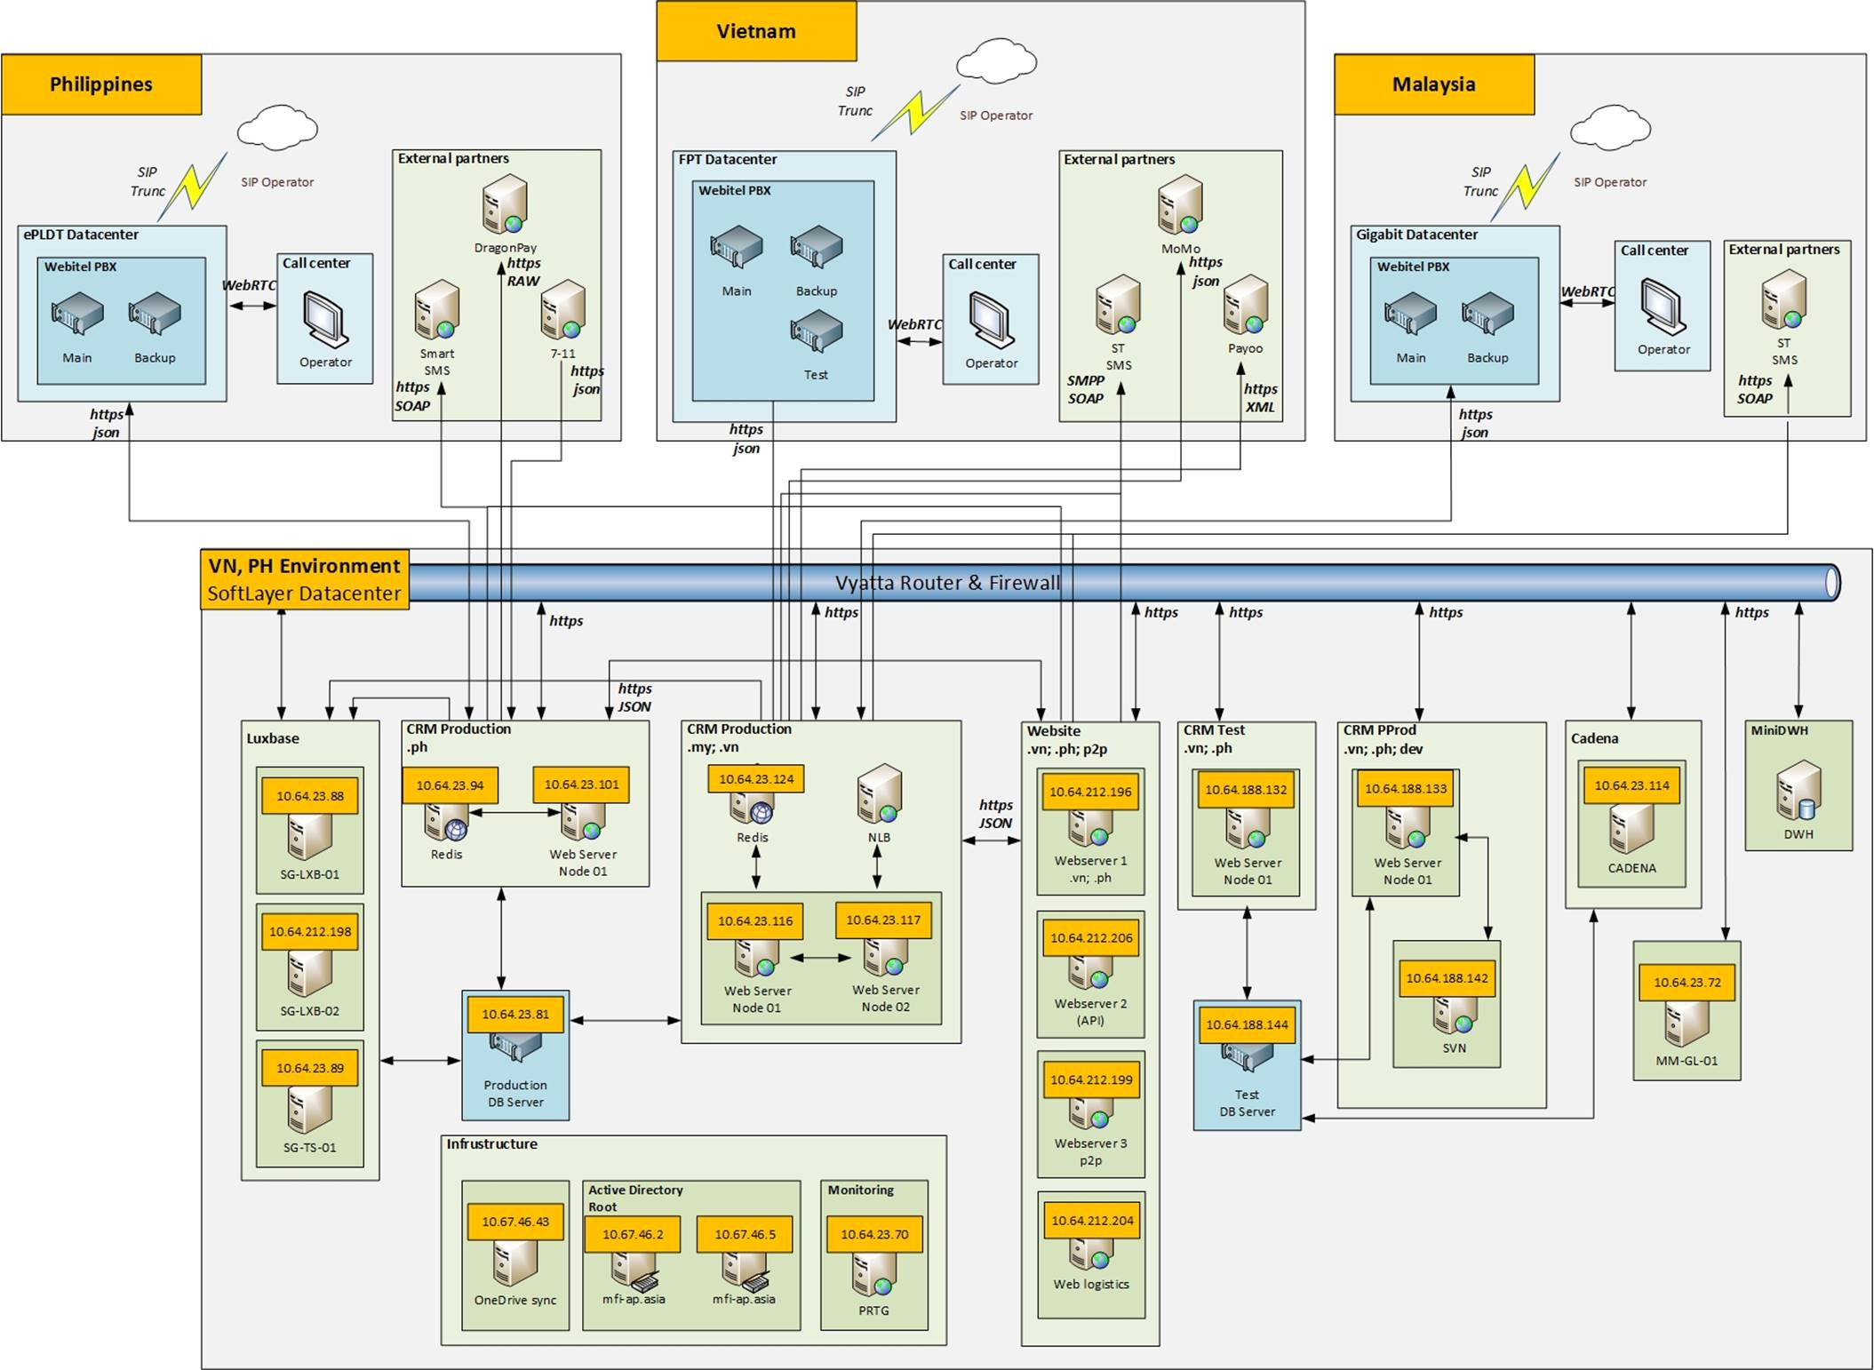
IT architecture geo layout

Slide 47
IT expenses: One-off and Fixed
Fixed IT expenses, thsd. USD
 | Year 1 | Year 2 | Year 3 | Year 4 | Year 5
 | -109 638 | -114 370 | -114 370 | -114 091 | -114 370
Internet | -36 000 | -36 000 | -36 000 | -36 000 | -36 000
Data center rent | -12 000 | -12 000 | -12 000 | -12 000 | -12 000
CC license | -6 138 | -8 370 | -8 370 | -8 091 | -8 370
GL license | -1 000 | -1 000 | -1 000 | -1 000 | -1 000
CRM Development - fixed part | -27 500 | -30 000 | -30 000 | -30 000 | -30 000
Software support | -27 000 | -27 000 | -27 000 | -27 000 | -27 000
One-off IT expenses, Total thsd. USD
 | -86
Web sites | -7
Mobile sites & app | -4
Collection system implementation | -19
СRM development | -56

Slide 48
HR & Admin Information

Slide 49
Organization chart
(1-3 month)
TOTAL:
8 people

Slide 50
Organization chart
(EOY 1)
TOTAL:
72 people

Slide 51
Organization chart
(EOY 5)
TOTAL:
275 people
We can have relative few amount of managers due to sharing resources of RH
We will relocate call center to suburban area of Yangon, this could help us to save around 40% of rent cost and 15% of salary cost from year 3
Organization chart for years 2019-2021 will be updated in 2018, however we do not expect growing of managers, only number of staff will grow according number of operations

Slide 52
Headcount and Personnel budget
Group/Position | Gross costs of employment, USD | Headcount |  |  |  |  | Monthly cost of employment, USD
 |  | EOY 1 | EOY 2 | EOY 3 | EOY 4 | EOY 5 | EOY 1 | EOY 2 | EOY 3 | EOY 4 | EOY 5
Total staff (fixed+variable) |  | 63 | 141 | 183 | 234 | 249 | 54 250 | 81 190 | 95 630 | 113 060 | 118 170
Total fixed staff |  | 23 | 23 | 23 | 23 | 23 | 40 050 | 40 050 | 40 050 | 40 050 | 40 050
Management and direct reports |  | 5 | 5 | 5 | 5 | 5 | 15 700 | 15 700 | 15 700 | 15 700 | 15 700
Operations department |  | 3 | 3 | 3 | 3 | 3 | 4 550 | 4 550 | 4 550 | 4 550 | 4 550
Risk department |  | 5 | 5 | 5 | 5 | 5 | 6 550 | 6 550 | 6 550 | 6 550 | 6 550
Financial department |  | 3 | 3 | 3 | 3 | 3 | 4 400 | 4 400 | 4 400 | 4 400 | 4 400
Marketing department |  | 1 | 1 | 1 | 1 | 1 | 1 500 | 1 500 | 1 500 | 1 500 | 1 500
Digital marketing department |  | 1 | 1 | 1 | 1 | 1 | 2 000 | 2 000 | 2 000 | 2 000 | 2 000
IT department |  | 1 | 1 | 1 | 1 | 1 | 2 000 | 2 000 | 2 000 | 2 000 | 2 000
HR department |  | 4 | 4 | 4 | 4 | 4 | 3 350 | 3 350 | 3 350 | 3 350 | 3 350
Total variable staff |  | 40 | 118 | 160 | 211 | 226 | 14 200 | 41 140 | 55 580 | 73 010 | 78 120
Operations department |  | 19 | 53 | 79 | 104 | 110 | 6 980 | 18 990 | 28 200 | 36 950 | 39 010
Verificator Teamleader | 480 | 1 | 2 | 2 | 2 | 2 | 480 | 960 | 960 | 960 | 960
Verificator | 350 | 7 | 17 | 20 | 26 | 26 | 2 450 | 5 950 | 7 000 | 9 100 | 9 100
Telesale operators Teamleader | 480 | 1 | 2 | 3 | 4 | 4 | 480 | 960 | 1 440 | 1 920 | 1 920
Telesale operators | 340 | 6 | 21 | 36 | 49 | 53 | 2 040 | 7 140 | 12 240 | 16 660 | 18 020
Customer support Teamleader | 480 | 1 | 1 | 2 | 2 | 2 | 480 | 480 | 960 | 960 | 960
Customer support | 350 | 3 | 10 | 16 | 21 | 23 | 1 050 | 3 500 | 5 600 | 7 350 | 8 050
Risk department |  | 21 | 65 | 81 | 107 | 116 | 7 220 | 22 150 | 27 380 | 36 060 | 39 110
Telecollector Teamleader | 480 | 1 | 4 | 4 | 5 | 6 | 480 | 1 920 | 1 920 | 2 400 | 2 880
Telecollector | 340 | 15 | 47 | 55 | 74 | 79 | 5 100 | 15 980 | 18 700 | 25 160 | 26 860
Field collector Teamleader | 480 | 1 | 1 | 2 | 2 | 2 | 480 | 480 | 960 | 960 | 960
Field collector | 290 | 4 | 13 | 20 | 26 | 29 | 1 160 | 3 770 | 5 800 | 7 540 | 8 410

Slide 53
Finance

Slide 54
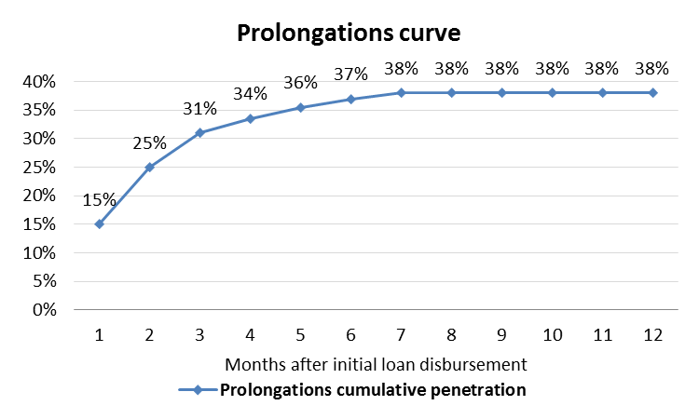
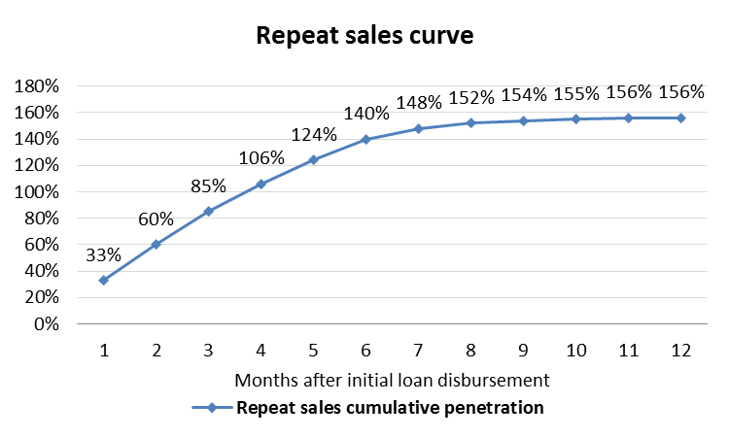
Financial model assumptions
Loan type | Avg term, days | Avg ticket, USD | Losses, %
New | 26 | 85 | 14.8%
Repeat | 26 | 125 | 11.3%
Prolongation new | 30 | 85 | 25.0%
Prolongation repeat | 30 | 125 | 25.0%
Year of project | 1 | 2 | 3 | 4 | 5
MAC, USD per loan | 48 | 10 | 10 | 10 | 10
Product parameters | Value
Normal interest rate, per day | 1.00%
Late penalty interest rate, per day | 2.00%
Late payment fee, USD | 15
Repeat sales per new loans | 156%
Prolongations per all loans | 38%

Slide 55
Investment summary
Investments, thsd USD | Year 1 | Year 2 | Year 3 | Year 4 | Year 5 | Total
Portfolio investments | 1 007 | 1 946 | 438 | 64 | 0 | 3 455
OPEX and CAPEX investments | 1 208 | 245 | 90 | 0 | 0 | 1 543
Total Micromoney investments | 2 215 | 2 191 | 529 | 64 | 0 | 4 998
Volume indicators | Year 1 | Year 2 | Year 3 | Year 4 | Year 5 | Total
Number of loans issued, thsd | 30 | 173 | 351 | 520 | 620 | 1 694
Amount disbursed, thsd USD | 2 484 | 14 095 | 28 198 | 41 569 | 49 284 | 135 630
Net portfolio (EoY), thsd USD | 612 | 2 059 | 3 634 | 5 000 | 5 348 | 16 652
P&L, thsd USD | Year 1 | Year 2 | Year 3 | Year 4 | Year 5 | Total
Revenue | 626 | 4 517 | 9 871 | 15 179 | 18 603 | 48 797
Provisions | -543 | -2 703 | -4 965 | -6 636 | -7 914 | -22 762
Variable costs | -510 | -1 272 | -2 337 | -3 400 | -3 979 | -11 498
Marketing acquisition costs | -369 | -608 | -1 112 | -1 577 | -1 775 | -5 441
Salary (variable part) | -94 | -340 | -548 | -781 | -927 | -2 690
Other variable costs | -40 | -199 | -359 | -530 | -631 | -1 759
VAT | -7 | -126 | -318 | -512 | -645 | -1 608
Fixed costs | -956 | -1 069 | -1 004 | -1 127 | -1 170 | -5 327
Salary (fixed part) | -682 | -701 | -588 | -713 | -793 | -3 476
Other G&A expenses | -275 | -369 | -416 | -414 | -377 | -1 851
One-off expenses | -57 | -17 | -17 | -17 | -17 | -126
Net profit before taxes | -1 441 | -545 | 1 548 | 3 999 | 5 523 | 9 084
Terminal value |  |  |  |  |  | 25 063
ROE (annualized) |  |  |  |  |  | 61%
ROAA (yearly) | -235% | -41% | 54% | 71% | 80% | 51%
Break-even period – 21 months; Self-capitalization period – 29 months; Payback period – 58 months
Total investments from Micromoney – $5,0M; Unoptimized Yr5 corporate tax – $1,4M
Terminal Value – $25,1M (Gordon growth model with discount factor 15% and growth rate 0%)

Slide 56
Balance Sheet, EOY
thsd USD | Year 1 | Year 2 | Year 3 | Year 4 | Year 5
Assets | 773 | 2 419 | 4 213 | 5 767 | 6 150
Liquid assets | 92 | 309 | 545 | 750 | 802
Loans to individuals (net of provisions) | 612 | 2 059 | 3 634 | 5 000 | 5 348
Total loans | 1 156 | 5 305 | 11 846 | 19 848 | 28 109
Risk provisions | -543 | -3 246 | -8 212 | -14 848 | -22 762
Other receivables | 69 | 52 | 35 | 17 | 0
Shareholders' equity | 773 | 2 419 | 4 213 | 5 767 | 6 150
Contributed equity | 2 215 | 4 406 | 4 934 | 4 998 | 4 998
Retained earnings | -1 441 | -1 986 | -438 | 2 630 | 6 773
Dividends paid | 0 | 0 | -282 | -1 861 | -5 620
Equity+Liabilities | 773 | 2 419 | 4 213 | 5 767 | 6 150

Slide 57
P&L Statement
thsd USD | Year 1 | Year 2 | Year 3 | Year 4 | Year 5 | Total
Interest Income | 626 | 4 517 | 9 871 | 15 179 | 18 603 | 48 797
Primary sales | 310 | 1 706 | 3 376 | 4 981 | 5 822 | 16 194
Repeat Sales | 316 | 2 811 | 6 496 | 10 198 | 12 781 | 32 603
Risk provisions | -543 | -2 703 | -4 965 | -6 636 | -7 914 | -22 762
Primary sales | -316 | -1 170 | -1 925 | -2 463 | -2 797 | -8 672
Repeat Sales | -227 | -1 533 | -3 040 | -4 173 | -5 116 | -14 090
Variable costs* | -510 | -1 272 | -2 337 | -3 400 | -3 979 | -11 498
Marketing acquisition costs | -369 | -608 | -1 112 | -1 577 | -1 775 | -5 441
Salary (variable part) | -94 | -340 | -548 | -781 | -927 | -2 690
Other variable costs | -40 | -199 | -359 | -530 | -631 | -1 759
VAT | -7 | -126 | -318 | -512 | -645 | -1 608
Operating profit (before fixed costs) | -428 | 542 | 2 569 | 5 143 | 6 711 | 14 537
Fixed costs* | -956 | -1 069 | -1 004 | -1 127 | -1 170 | -5 327
Salary (fixed part) | -682 | -701 | -588 | -713 | -793 | -3 476
Other G&A expenses | -275 | -369 | -416 | -414 | -377 | -1 851
One-off expenses | -57 | -17 | -17 | -17 | -17 | -126
Profit before Taxes** | -1 441 | -545 | 1 548 | 3 999 | 5 523 | 9 084
* See slides 58-59 for details
** Estimated amount of profit tax for 5th year is $1.4M

Slide 58
Cash flow statement
thsd USD | Year 1 | Year 2 | Year 3 | Year 4 | Year 5 | Total
Loans issued | -2 484 | -14 095 | -28 198 | -41 569 | -49 284 | -135 630
Principals received | 1 328 | 9 946 | 21 658 | 33 567 | 41 023 | 107 521
Interest received | 626 | 4 517 | 9 871 | 15 179 | 18 603 | 48 797
Loan fees received | 0 | 0 | 0 | 0 | 0 | 0
Fines & penalties received | 0 | 0 | 0 | 0 | 0 | 0
Total CF from business activities: | -530 | 368 | 3 331 | 7 177 | 10 341 | 20 687
Commissions to agents & payment systems | -7 | -49 | -102 | -156 | -188 | -502
POS costs | 0 | 0 | 0 | 0 | 0 | 0
People costs | -766 | -983 | -1 018 | -1 318 | -1 506 | -5 591
Marketing & Acquisition costs | -378 | -665 | -1 230 | -1 753 | -1 989 | -6 015
Support costs | -17 | -62 | -97 | -142 | -156 | -475
Office costs | -180 | -350 | -470 | -540 | -558 | -2 099
IT costs | -154 | -70 | -70 | -70 | -70 | -434
Professional services | -40 | 0 | 0 | 0 | 0 | -40
Other income (expenses) | -43 | -36 | -36 | -36 | -36 | -187
Profit tax | 0 | 0 | 0 | -930 | -1 381 | -2 311
VAT paid | -7 | -126 | -318 | -512 | -645 | -1 608
Working Capital required | 0 | 0 | 0 | 0 | 0 | 0
Total CF from operating expenses: | -1 593 | -2 342 | -3 341 | -5 457 | -6 530 | -19 263
Total CF from operating activities: | -2 123 | -1 974 | -10 | 1 720 | 3 812 | 1 425
Financing received | 2 215 | 2 191 | 529 | 64 | 0 | 4 998
Financing returned | 0 | 0 | -282 | -1 579 | -3 759 | -5 620
Interest expense | 0 | 0 | 0 | 0 | 0 | 0
Total CF from financing activities: | 2 215 | 2 191 | 246 | -1 515 | -3 759 | -623
CAPEX | 0 | 0 | 0 | 0 | 0 | 0
Total CF for the period: | 92 | 217 | 236 | 205 | 52 | 802
Cash balance beginning: | 0 | 92 | 309 | 545 | 750 | 750
Cash balance ending: | 92 | 309 | 545 | 750 | 802 | 802

Slide 59
Expenses detailed
Variable costs, thsd. USD
Expenses category | Year 1 | Year 2 | Year 3 | Year 4 | Year 5 | Total
Marketing acquisition costs | -369 | -608 | -1 112 | -1 577 | -1 775 | -5 441
Salary (variable part) | -94 | -340 | -548 | -781 | -927 | -2 690
Other variable costs | -40 | -199 | -359 | -530 | -631 | -1 759
Telecommunications - acquisition | -11 | -43 | -74 | -108 | -127 | -362
Outbound SMS - acquisition | -6 | -31 | -61 | -90 | -105 | -293
Payment system fees | -7 | -49 | -102 | -156 | -188 | -502
Telecommunications - support | -14 | -62 | -95 | -136 | -163 | -470
Outbound SMS - support | -2 | -14 | -27 | -40 | -48 | -131
VAT | -7 | -126 | -318 | -512 | -645 | -1 608
Total | -510 | -1 272 | -2 337 | -3 400 | -3 979 | -11 498
Fixed costs, thsd. USD
Expenses category | Year 1 | Year 2 | Year 3 | Year 4 | Year 5 | Total
Salary (fixed part) | -682 | -701 | -588 | -713 | -793 | -3 476
Salary | -462 | -481 | -481 | -481 | -481 | -2 384
Bonuses | -220 | -220 | -107 | -232 | -312 | -1 092
Other G&A expenses | -275 | -369 | -416 | -414 | -377 | -1 851
Rent/office expenses | -120 | -209 | -265 | -260 | -232 | -1 086
IT expenses | -112 | -124 | -115 | -118 | -109 | -578
Miscellaneous | -43 | -36 | -36 | -36 | -36 | -187
Total | -956 | -1 069 | -1 004 | -1 127 | -1 170 | -5 327

Slide 60
One-off expenses
Expenses category | Total, thsd USD
HR expenses | -40
Recruiting | -40
IT expenses | -86
СRM development | -56
Collection system implementation | -19
Web sites | -7
Mobile sites&app | -4
Total | -126

Slide 61
Project Plan

Slide 62
Project Plan
Activity | Planning end date | Comments
Hiring CEO | 30/07/2016 | Done
Licensing | 30/09/2016 | Done (pawnshop)
Renting offices | 01/11/2016 | We plan to rental office from begin of November
Creating team | 30/11/2016 | In process
IT Development, product settings | 01/01/2017 | We understand all our partners for integration
Official documents | 15/11/2016 | We will use law advisor company for preparing all documents
Start sales | 15/01/2017
Activity | Sept-16 | Oct-16 |  | Nov-16 | Dec-16 | Jan-17
licensing
Renting office
Creating team
IT Development, product settings
Official documents for customers and regulator
Start operations
We are planning to launch operations in January 17.

Slide 63
Appendix

Slide 64
Core team salary expenses
Employee position | Level | MM monthly salary | APAC average salary | Difference | Joining period
Chief operating officer | B-1 | $ 6 500 | $ 3 671 | +2829 | done
Head of call center | B-1 | $ 1 500 | $ 1 059 | +441 | up to 3 months
Head of collection | B-1 | $ 2 000 | $ 2 040 | -40 | up to 3 months
Chief financial officer | B-1 | $ 2 500 | $ 5 416 | -2916 | up to 3 months
HR Director | B-1 | $ 2 000 | $ 2 302 | -302 | up to 3 months
Head of Sales & Marketing | B-1 | $ 2 000 | $ 2 137 | -137 | up to 3 months
Legal manager | B-1 | $ 3 000 | - | - | up to 3 months
IT Manager | B-1 | $ 2 000 | $ 2 224 | -224 | up to 3 months
Disbursement & repayment manager | B-2 | $ 1 000 | - | - | up to 3 months
Head of risk management team | B-2 | $ 3 500 | $ 4 280 | -780 | up to 3 months
Credit risk manager | B-3 | $ 700 | - | - | up to 6 months
Anti-fraud manager | B-3 | $ 700 | - | - | up to 6 months
Quality control manager | B-1 | $ 1 000 | $ 959 | -41 | up to 12 months
Accountant | B-2 | $ 700 | - | - | up to 12 months
Reporting manager | B-2 | $ 700 | - | - | up to 12 months
Reqrutment manager | B-2 | $ 600 | - | - | up to 12 months
Training & development manager | B-2 | $ 800 | - | - | up to 12 months
Personal admin & payroll manager | B-2 | $ 600 | - | - | up to 12 months
Digital sales manager | B-2 | $ 1 000 | - | - | up to 12 months
Business development manager | B-2 | $ 1 000 | - | - | up to 12 months

Slide 65
Mass team salary expenses
Employee position | MM monthly salary | APAC average salary | Difference | EOY1 total expense | EOY2 total expense | EOY3 total expense | EOY4 total expense | EOY5 total expense
Phone verification team lead | $ 480 | $ 1 315 | - 315 | $ 5 400
Phone verifier | $ 350 | $ 354 | -4 | $ 17 150
Telemarketing team lead | $ 480 | $ 1 059 | - 579 | $ 8 400
Telemarketing spec. | $ 350 | $ 338 | +12 | $ 9 860
Customer service team lead | $ 480 | $ 593 | -113 | $ 6 650
Customer service spec. | $ 350 | $ 468 | -118 | $ 6 650
Pre due group team lead | $ 480 | - | - | $ 5 400
Pre due specialist | $ 340 | - | - | $ 14 000
Phone collection team lead | $ 480 | $ 580 | -100 | $ 4 400
Phone collector | $ 340 | $ 498 | -158 | $ 15 240
Field collection team lead | $ 480 | $ 564 | -84 | $ 4 400
Field collector | $ 290 | $ 345 | -55 | $4 060
Total: | $ 5 420 | $ 5 055* |  | $ 101 610

Slide 66
Detailed Headcount and Personnel budget
Employee position | MM monthly salary | APAC average salary | Difference | EOY1 total expense | EOY2 total expense | EOY3 total expense | EOY4 total expense | EOY5 total expense
Phone verification team lead | $ 480 | $ 1 315 | - 315 | $ 5 400
Phone verifier | $ 350 | $ 354 | -4 | $ 17 150
Telemarketing team lead | $ 480 | $ 1 059 | - 579 | $ 8 400
Telemarketing spec. | $ 350 | $ 338 | +12 | $ 9 860
Customer service team lead | $ 480 | $ 593 | -113 | $ 6 650
Customer service spec. | $ 350 | $ 468 | -118 | $ 6 650
Pre due group team lead | $ 480 | - | - | $ 5 400
Pre due specialist | $ 340 | - | - | $ 14 000
Phone collection team lead | $ 480 | $ 580 | -100 | $ 4 400
Phone collector | $ 340 | $ 498 | -158 | $ 15 240
Field collection team lead | $ 480 | $ 564 | -84 | $ 4 400
Field collector | $ 290 | $ 345 | -55 | $4 060
Total: | $ 5 420 | $ 5 055* |  | $ 101 610

Slide 67
Largest banks in Myanmar: Domestic remittance
Bank | YANGON branches | MANDALAY branches | Naypyidaw branches | Total | % of total branches | Total network branches across the country
KBZ Bank | 146 | 95 | 8 | 249 | 64% | 391
CB Bank | 74 | 36 | 7 | 117 | 73% | 161
AYA Bank | 66 | 25 | 5 | 96 | 61% | 157
MAB Bank | 21 | 8 | 3 | 32 | 42% | 77
GT Bank | 22 | 10 | 4 | 36 | 30% | 120
Bank`s domestic remittance:
possible to send money to an individual without opening an account
possible to send money to any branch of bank (average time to open bank account – 30 minutes )
If there was now withdrawal, the money can be return back to sender
KYC:
Full Name of receiver
Home address
NRC number (passport)
Phone number

Slide 68
Governing bodies in Myanmar | Structure
President
Agricultural, Livestock and Irrigation Ministry
Ministry of planning and Finance
Central bank of Myanmar
Prime Minister of Yangon region
Co-op department
Financial Regulatory Department (FRD)
Banks
Financial companies
Yangon mayor
Co-operatives
Rural Development and Poverty Reduction Working Committee
Microfinance Supervisory Bureau
Yangon City Development Committee (YCDC)
Microfinance Supervisory committee
Pawnshops
MFIs

Slide 69
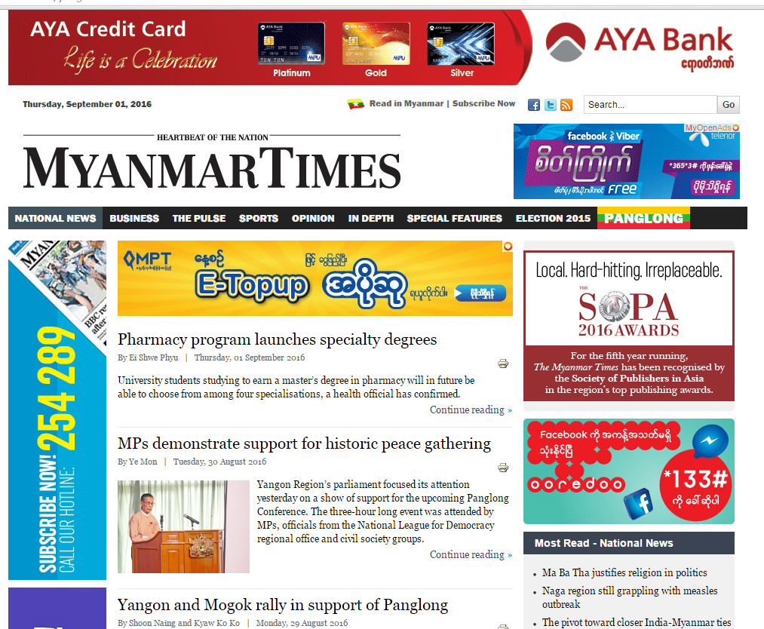
Online marketing toolkit: Local Display network
Text & Banner Ad Targeting Opportunities
Audiences on the Local Display Network are targeted using:
• Keywords
• Topics
• Interests
• Age
• Gender
• Devices
• Language
• Location (Country, State, City)
Category Targeting
• Finance
• Travel
• Health
• Loan Specific
• Competitor Specific
Digital Market is developing very fast.
We will use the same marketing strategy as in other APAC markets.

Slide 70
Markets comparison
Country statistics | VN | PH | ID | MM | CN | MY
Population, mln | 91 | 101,9 | 255 | 51 | 1 376 | 31
GDP per capita (nominal), thsd USD | 2,3 | 3,2 | 3,5 | 1,4 | 8,8 | 12,2
Labor force ratio | 62% | 63% | 67% | 68% | 58,3 | 66%
Average monthly salary, USD | 200 | 208 | 250 | 120 | 730 | 961
Smartphone penetration | 20% | 50% | 25% | 58% | 56% | 63%
Bank account penetration | 21% | 27% | 20% | 5% | 64,7% | 66%
Volume indicators (year 5) | VN | PH | ID | MM | CN | MY
Loans issued in year 5, thsd including prolongations | 1 291 | 441 | 464 | 620 | 1154 | 198
Loans issued per day in year 5 including prolongations | 3537 | 1208 | 1271 | 1698 | 3160 | 542
Investment parameters | VN | PH | ID | MM | CN | MY
Investment, mln USD | 15,7 | 8,8 | 11,0 | 4,5 | 31,4/15,8* | 8,6
capex + opex | 5,1 | 4,1 | 4,4 | 3,3 | 12,2 | 4,7
portfolio financing | 10,6 | 4,8 | 6,6 | 1,1 | 3,4 | 3,9
Break-even period, months | 15 | 20 | 20 | 22 | 25 | 18
Payback period, months | 19 | 49 | 50 | 31 | 45 | 51
Revenue, (Year 5), mln USD | 71 | 42,2 | 53,9 | 18,5 | 130 | 37,3
Profit before taxes, (Year 5), mln USD | 19 | 15,5 | 16,8 | 5,5 | 42 | 15,3
*China investments total $31,4 mln (15,8 Micromoney investments + 15,5 debt financing)

Slide 71
Salaries comparison. APAC survey
Job Title | Head of Accounting and Finance | HR Manager | IT Manager | Digital Marketing Manager | Head of Operations | Quality Control Head | Telemarketing Head | Senior Telemarketing Specialist | Telemarketing Specialist | Customer Service Team Leader | CSR
Job Title | 5 | 4 | 5 | 4 | 3 | 3 | 1 | 2 | 25 | 3 | 5
# Incumbents | $3 239 | na | $1 905 | $1 811 | $4 775 | $1 059 | $1 059 | $338 | $258 | $631 | $270
VN | $5 090 | $2 134 | $2 560 | $2 560 | $4 171 | $1 067 | na | na | $294 | $640 | $293
PH | $1 918 | $1 723 | $2 401 | na | $2 068 | $752 | na | na | na | $508 | $376
ID | $4 625 | $3 250 | $1 625 | $1 625 | na | na | na | na | na | na | $500
MY | $12 207 | $2 102 | $2 628 | $2 553 | na | na | na | na | na | na | $901
CN | $1 918 | $1 723 | $1 625 | $1 625 | $2 068 | $752 |  |  |  | $508 | $293
Min | $12 207 | $3 250 | $2 628 | $2 560 | $4 775 | $1 067 |  |  |  | $640 | $901
Max | $5 416 | $2 302 | $2 224 | $2 137 | $3 671 | $959 | $1 059 | $338 | $276 | $593 | $468
Average | $4 625 | $2 118 | $2 401 | $2 182 | $4 171 | $1 059 | $1 059 | $338 | $276 | $631 | $376
Job Title | Phone Verification Manager | Phone Verification Team Leader | Phone Verifier | Assistant Phone Verifier | Data Checking Team Leader | Data Checker | Head of Risk Management | Head of Collection | Field Collection Team Leader | Senior Field Collector | Field Collector | Phone Collection Team Leader | Phone Collector
# Incumbents | 2 | 4 | 54 | 5 | 1 | 13 | 4 | 4 | 3 | 2 | 32 | 2 | 58
VN | $1 505 | $374 | $270 | $225 | $338 | $285 | $3 829 | $2 297 | $450 | $315 | $216 | $720 | $283
PH | na | $533 | $277 | na | na | $288 | na | $1 707 | na | na | $277 | $512 | $288
ID | na | $526 | $368 | na | na | na | $3 910 | $1 654 | $677 | $375 | $301 | $508 | $366
MY | na | na | $500 | na | na | $458 | $3 000 | $2 500 | na | na | na | na | $500
CN | $1 126 | na | na | na | na | na | $6 381 | na | na | na | na | na | $1 051
Min |  | $374 | $270 |  |  | $285 | $3 000 | $1 654 |  |  | $216 | $508 | $283
Max |  | $533 | $500 |  |  | $458 | $6 381 | $2 500 |  |  | $301 | $720 | $1 051
Average | $1 315 | $478 | $354 | $225 | $338 | $344 | $4 280 | $2 040 | $564 | $345 | $265 | $580 | $498
Median | $1 315 | $526 | $323 | $225 | $338 | $288 | $3 869 | $2 002 | $564 | $345 | $277 | $512 | $366

Slide 72

Mingalar Myanmar Microfinance
Description of Business | Starting from August 2012, Mingalar Myanmar received the license to operate in 10 townships in Yangon. Mingalar Myanmar is a deposit-taking non-governmental organization by nature but operates a for-profit business model. Mingalar Myanmar has been conducting Microfinance operations before the passing of Microfinance law thus it does not believe in abiding by every clause established by the law. For example, it provides much higher loan size than the instructed USD 5000. In fact, the average loan size for Mingalar Myanmar doubles the instructed loan size. Additionally, it extends loans to individuals rather than practicing the traditional group lending model. The company has been profitable according to its practices but risks losing operating license due to breaching of the law.
Main Markets and Main Products | There is only one loan product provided by Mingalar Myanmar, which is the Micro-Business loan. This loan requires a guarantor who will be held responsible to repay their loan if the client fails to do so.
Key Financials (2014 Year) | Loan Portfolio | 1,6 mln USD
 | Average Loan Size | 10 USD
 | Non Performing Loan | 3% of portfolio
Branches network | Mingalar Myanmar has only one office located in Yangon, they operate mainly in urban area.
Profile of its clients and their needs | Mingalar Myanmar targets small-medium enterprise owners who has guarantors who will be responsible in case of bad loan. Mingalar Myanmar does not lend to staffs or employees. Clients of Mingalar Myanmar are those who need support to fund their businesses and, or take the business to another level.
Advertising | Brochures
* Thura Swiss

Slide 73
Pyae Mahar Microfinance
Description of Business | Pyae Mahar Microfinance was founded in September 2012 with a vision to improve the lives and futures of vulnerable populations and to create better economic opportunities for them
Main Markets and Main Products | General Loan Bi-weekly repayment for 25 installments 1st Cycle – 50 USD 2nd Cycle – 70 USD 3rd Cycle – 100 USD
 | Agri Loans (For Production of betal leaves, paddy, vegetables, water-mimoso, etc.) Only interest bi weekly, principal repayment is at harvesting time 100 to 300 USD
 | Emergency Health Loans Only interest for grace period 4 bi-weekly installments and repayment for 10 bi-weekly installments 50 USD
Key Financials (2014 Year) | Total Loan Book | 667K USD
 | Average Loan Size | Varies on the type of loan
 | Non-Performing Loan | 0
Branches network | Townships | 5
 | Village Tracts | 116
 | Villages | 351
 | Households | 44,921
* Thura Swiss

Slide 74
Tun Foundation Finance
Description of Business | Started from 2008 for Cyclone Nargis re-habilitation of homelands in Kun Chan Kone/Za Lun Officially start operation as an MFI in 2011 with official license The MFI is operated as independent Financial Company owned by Tun Foundation Chairman Non-deposit taking institution
Main Markets and Main Products | Agriculture loan Only for group lending (includes 5-10 people in a group) Loan term → -Seasonal depending on the type of agriculture product -Usually 4 months (minimum) and 10 months (maximum)
Key Financials (2014 Year) | Loan Outstanding | 84K USD
 | Average Loan Size | -25 USD per acre -240 USD maximum per person depends on the region’s pay back pattern
Branches network | Main Head Office | Yangon
 | Ayeyarwaddy | Zalun, Warr Khae Ma, Ma U Bin (Whole)
 | Mandalay | Kyauk Pataung (as a whole)
 | Yangon | Kun Chan Gone (36 villages as a whole)
Profiles of its clients and their needs | 100% farmers Client base → more than 3,000 clients (only to whom that owns wet lands) Since the MFI mainly focus on agriculture loans, most of the clients are from Ayarwaddy Delta region which comprises around 2,700 clients in 27 villages of Ayarwaddy. Mandalay → around 600 clients Yangon → around 500 clients
Advertising | Brochures
* Thura Swiss

Slide 75

ACLEDA MFI Myanmar Co., Ltd.
Description of Business | ACLEDA MFI Myanmar Co., Ltd. was founded in February 2013. Mission of ACLEDA is to provide micro and small entrepreneurs with the wherewithal to manage their financial resources efficiently and by doing so to improve the quality of their lives
Main Markets and Main Products | •Group and individual Loans
 | For Group Member
 | •Organize a group of 2 to 10 people
 | •Tenor period 1 - 18 m. Loan size 80$-1000$ for per member
 | For Individual
 | •Tenor period 1 - 24 m. Loan size 80$ - 1600$
 | Savings Account
 | •Initial deposit only 1$
 | •Minimum balance is not required
 | •No service charged for account opening or closing
Key Financials (2014 Year) | Loans and Advances - Net | 7 mln $
 | Average Loan Size | Varies on the type of loan
 | Deposits | 250K $
 | Profit Before Income Tax | 1 mln $
 | Net Profit After Tax | 794K $
Branches network | Townships | 15
Advertising | On the web-site, brochures, billboard
http://www.acledamfi.com.mm

Slide 76

Fullerton Finance Myanmar Co., Ltd.
Description of Business | Fullerton Finance Myanmar Co., Ltd. was founded in November 2014. Mission of Fullerton: Our products are Simple, Convenient, and approval is fast, meeting our customers needs.
Main Markets and Main Products | Group Loans
 | Solidarity Group Loans for groups of 5
 | Loan sizes 40$ - 400$, tenor period 3 - 12 months.
 | Individual Loans
 | Loan sizes 40$ - 400$, tenors period 6 - 18 months.
 | For personal use, or to assist in micro business working capital.
 | Easy application requiring National Registration ID, home address proof.
 | Deposits
 | Initial deposit 1$
 | Minimum balance is not required
Key Financials (2014 Year) | Loans | 2,6 mln USD
 | Average Loan Size | Varies on the type of loan
Branches network | Townships | 12
Advertising | On the web-site, brochures, billboard
https://www.fullertonmyanmar.com

